Slide 1
Journaling Tool
Image Operations Dictionary
5/23/2017

Slide 2
Introduction
This guide aims to define both visually and verbally which manipulation each operation is intended to represent.
Any combination of operations of can be used in manipulations.
Operations expect specific input.
Change masks and operations that contribute to the Composite must be checked for accuracy.
Operations can both effect a whole image (globally) or parts (locally)

Slide 3
Operation Groups
AdditionalEffect
AntiForensic
CGI
Color
Filter
Groups
Intensity
Laundering
Layer
Output
Paste
PostProcessing
Select
Transform

Slide 4
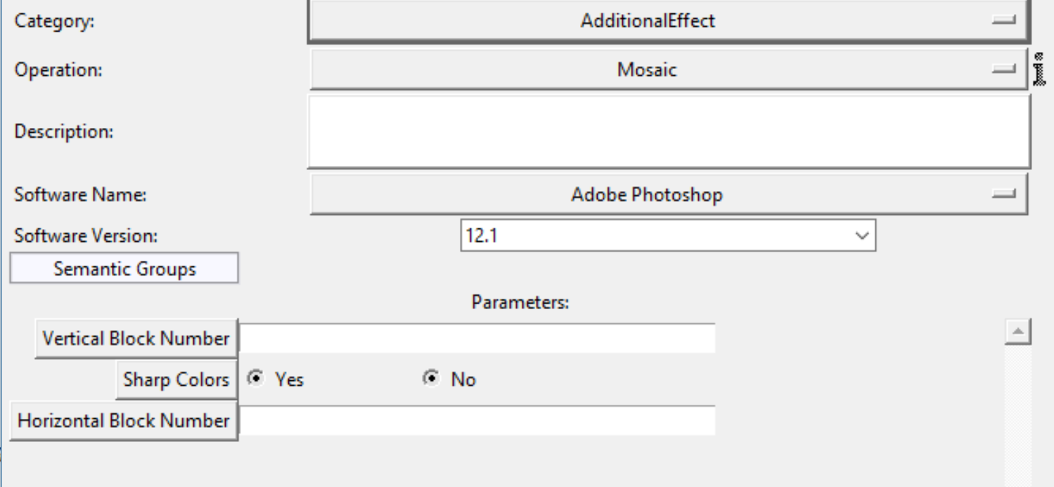
Additional Effects
Mosaic

Slide 5
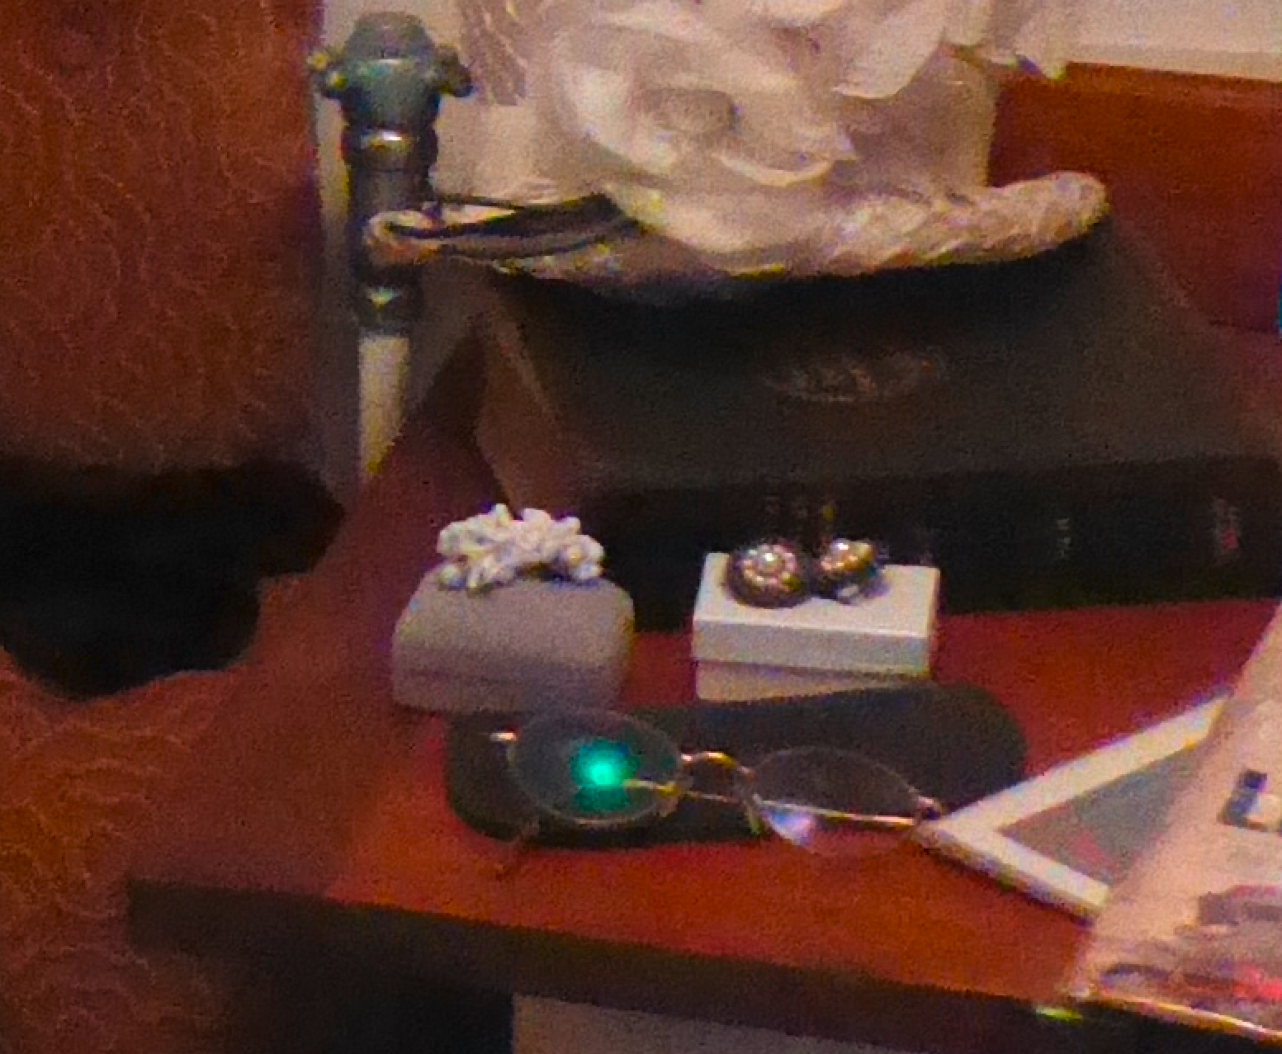
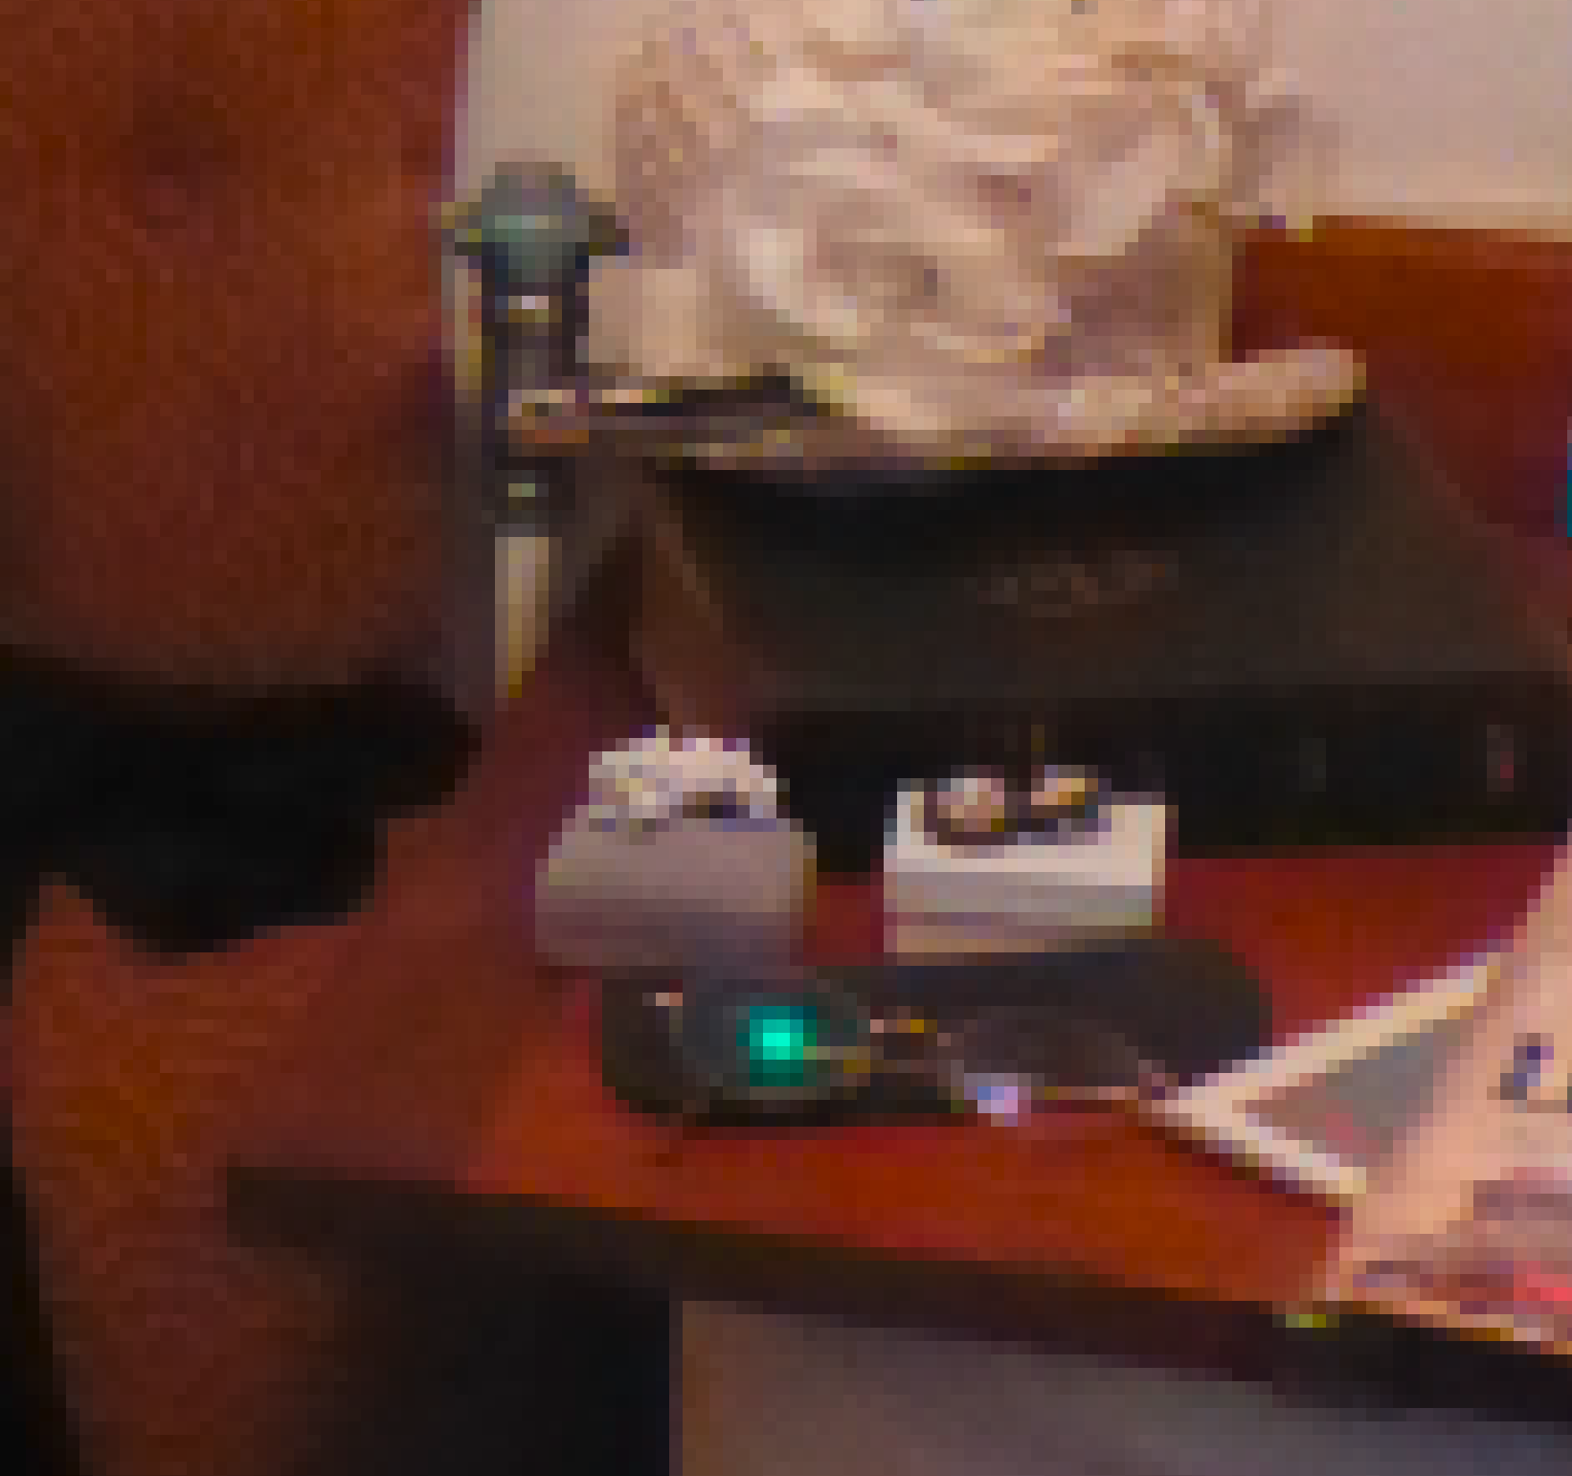
Mosaic
Making image look blocky
Expected input:
Number of horizontal blocks
Number of vertical blocks
Sharp Colors (Yes/No)
original
7x7 mosaic, sharp colors,No

Slide 6
AntiForensic
AntiForensicCopyExif
AddCamFingerprintAveragePRNUFromSet
AberrationCorrection
LensDistortion
AntiForensicEditExif
AntiForensicJPGCompression
RemoveCameraFingerprintPRNU
AntiForensicExifQuantizationTable
AntiForensicDither
CFACorrection
RemoveCamFingerprintPRNUFromSet
AddCamFingerprintPRNU

Slide 7
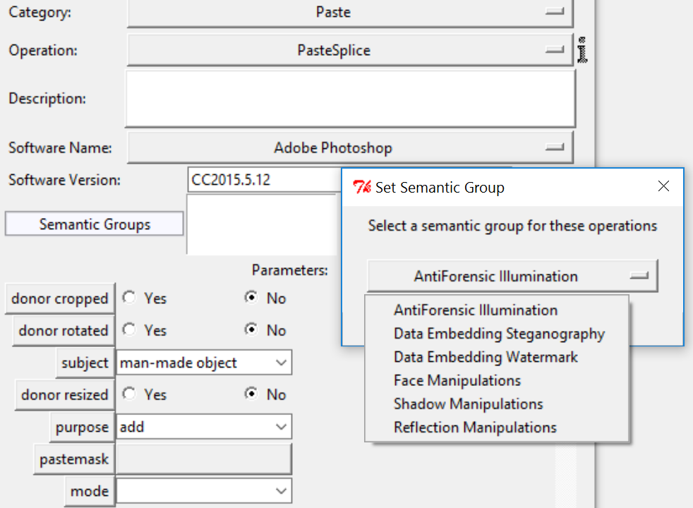
CGI
Artificial Lighting
OverlayObject
DigitalPenDraw
Handwriting
ObjectCGI
OverlayText
Gradient
ArtificialReflection
ArtificalShadow
CGIFill
Use artificial reflection and artificial shadow whenever adding them in the image, if they are for a CGI object or not. This could include the drop shadow effect, etc.
Do not forget to tag any appropriate links with the correct semantic group.

Slide 8
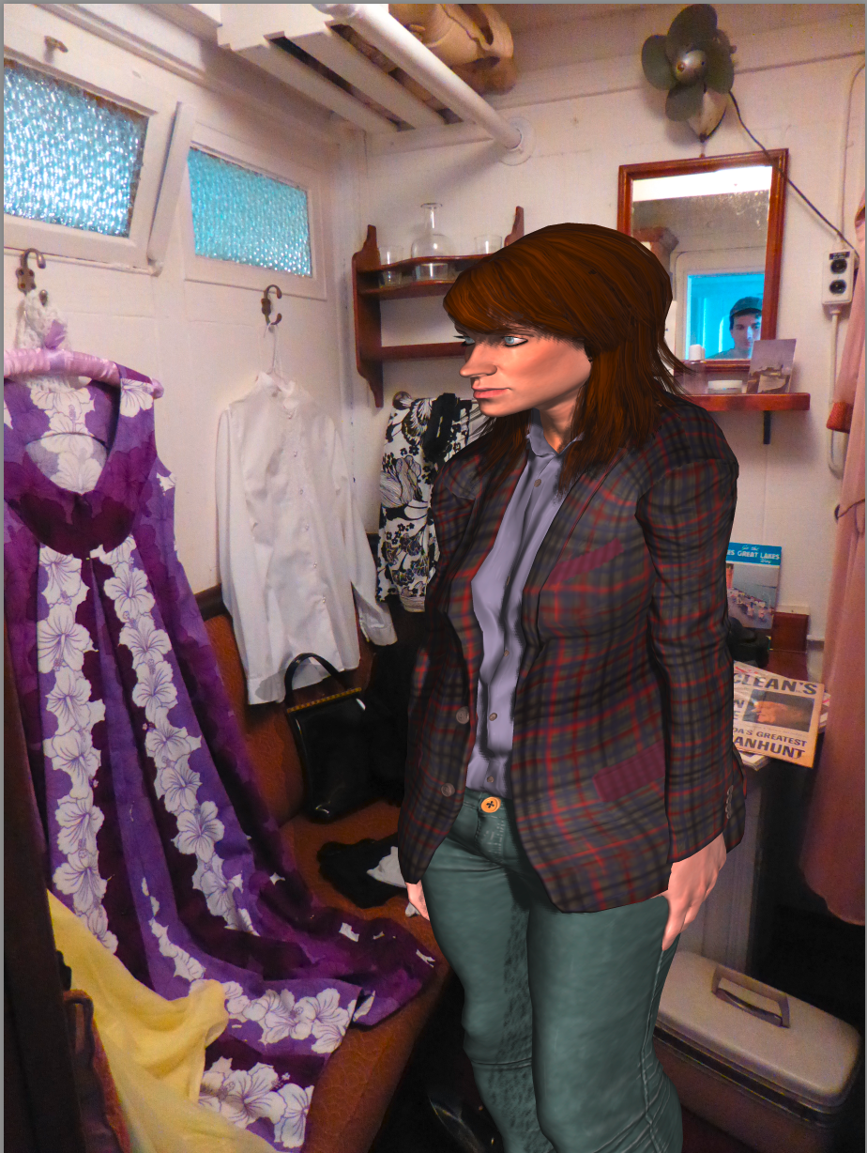
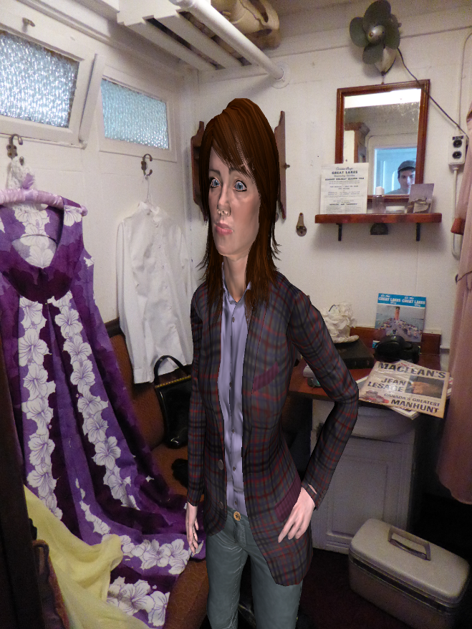
ArtifactsCGI
ObjectCGI
ArtificialLighting

Slide 9
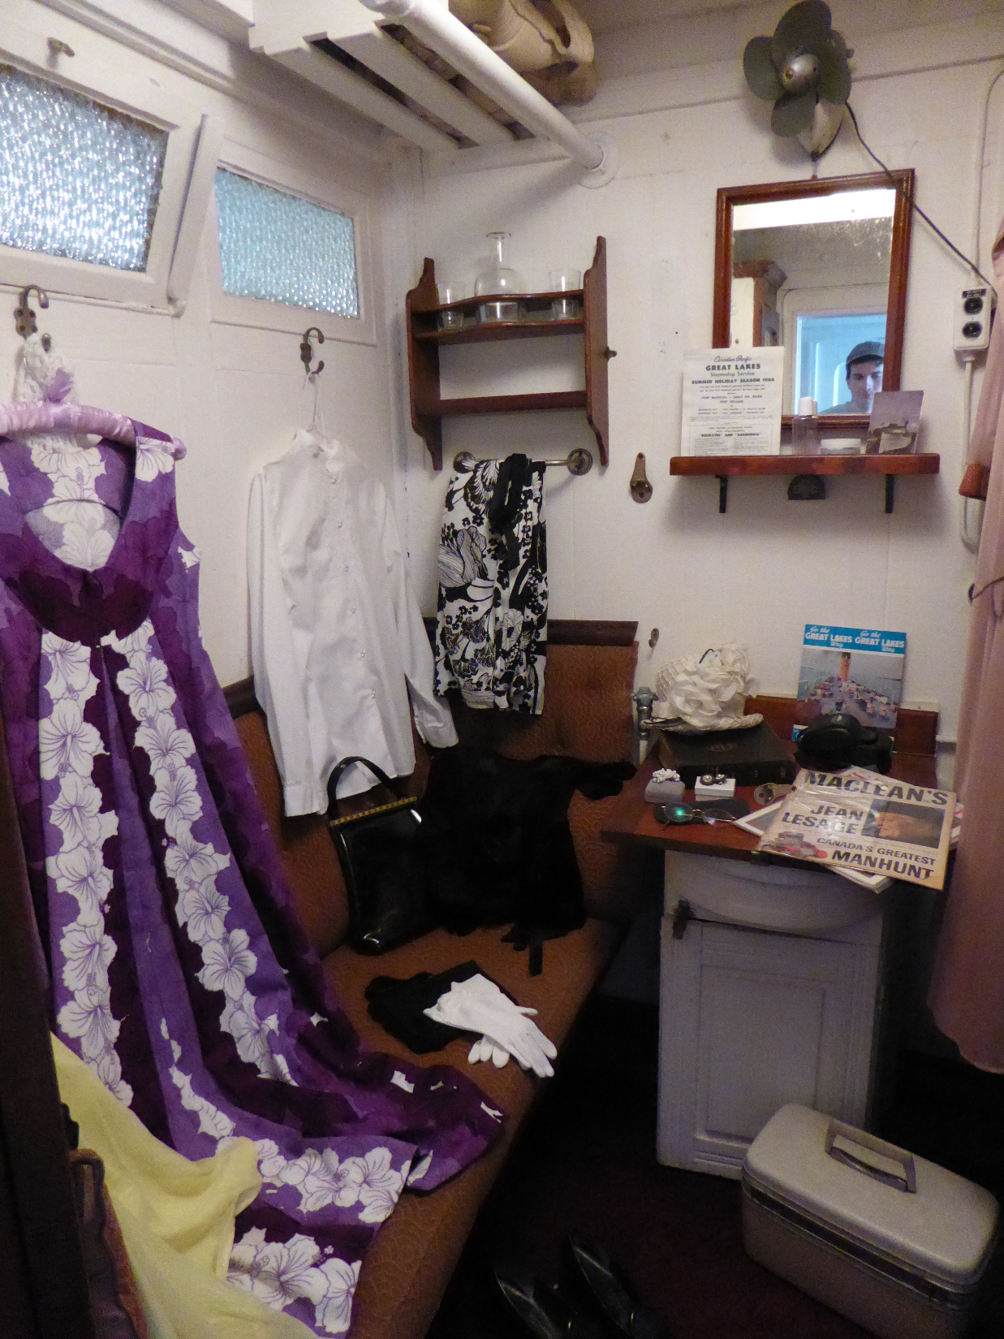

Add Lighting
ArtificialReflection
ArtificialShadow
ArtificialLighting
Pasted object
Artificial shadow added

Slide 10
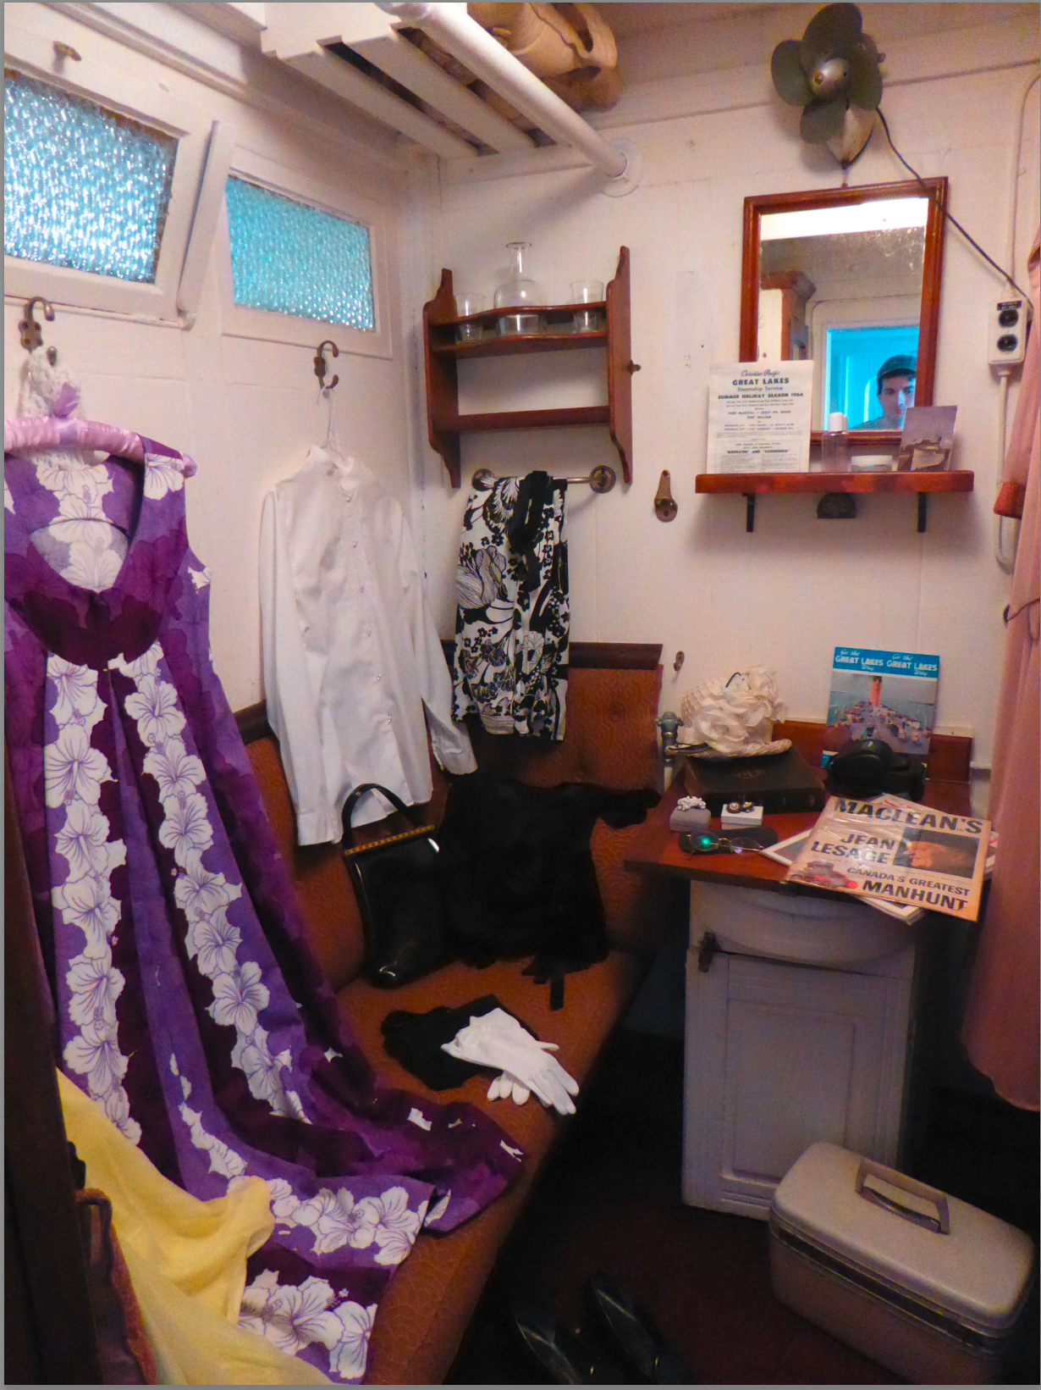
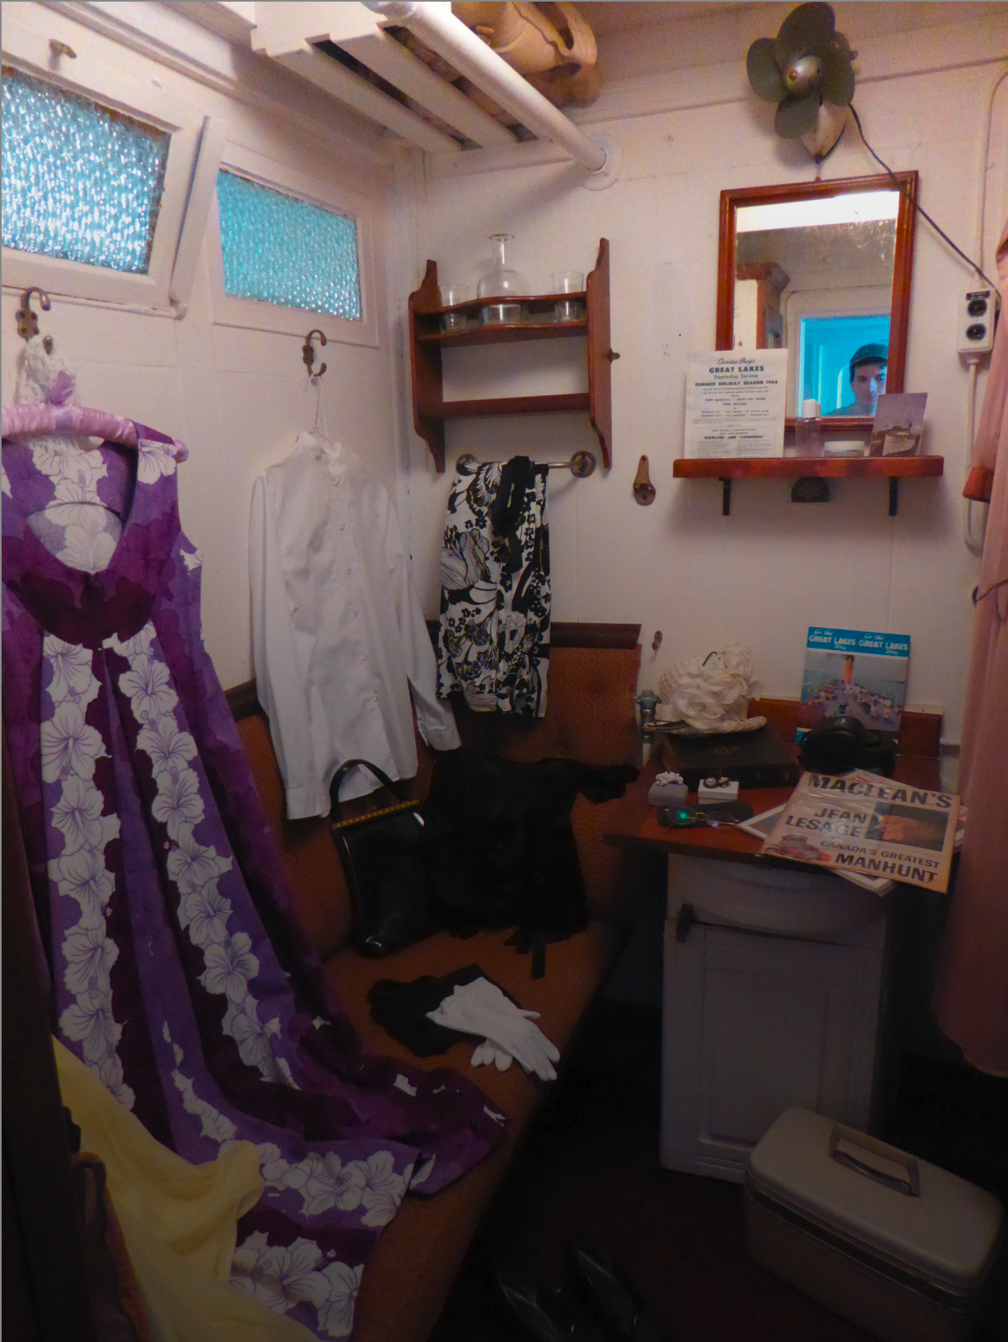
gradient
Add Gradient on top of an image
A gradient CGI was added over the image to gradually darken the image
original
with gradient

Slide 11
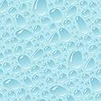
CGI
Gradient
DigitalPenDraw
CGIFill
Background
Pattern
Gradient
DigitalPenDraw
CGIFill
CGIFill

Slide 12
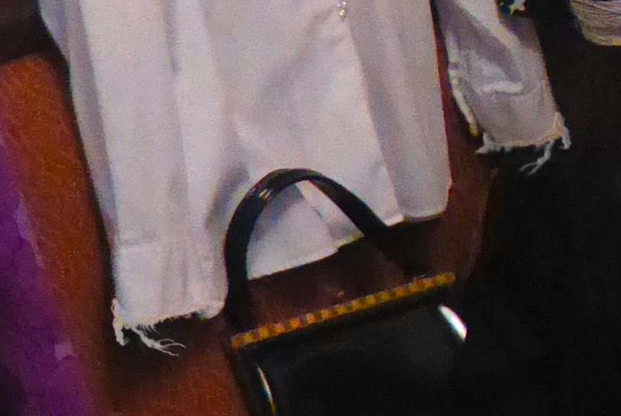
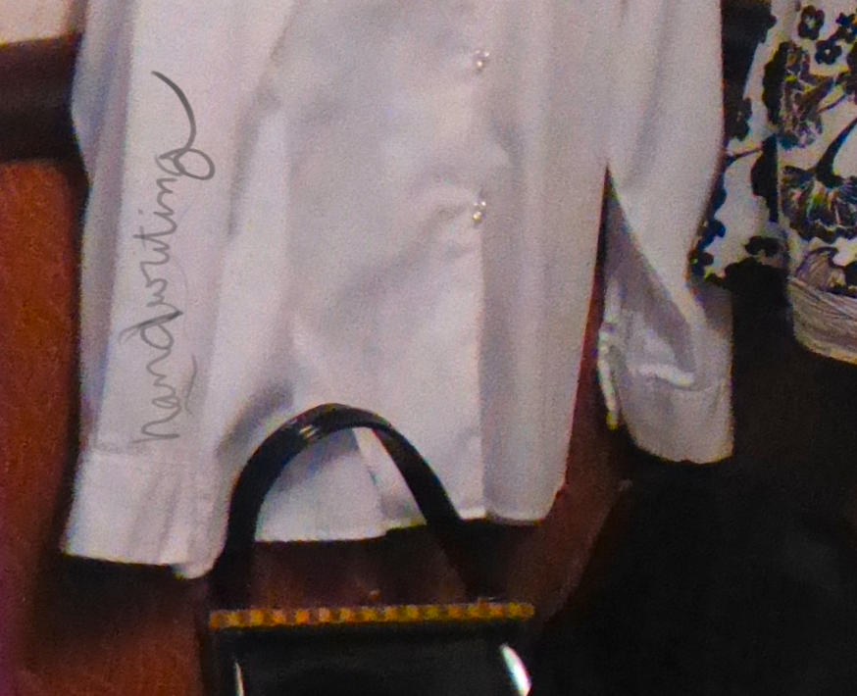
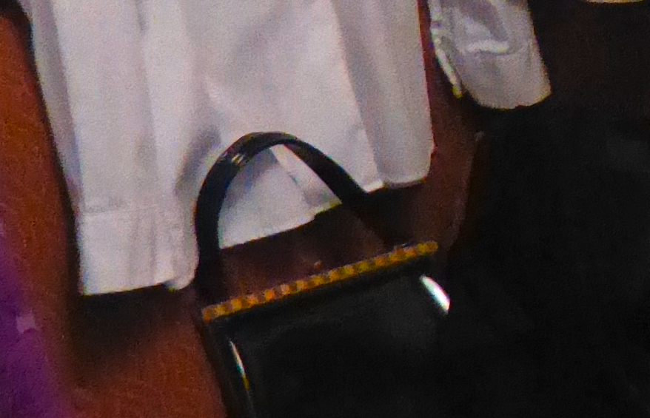
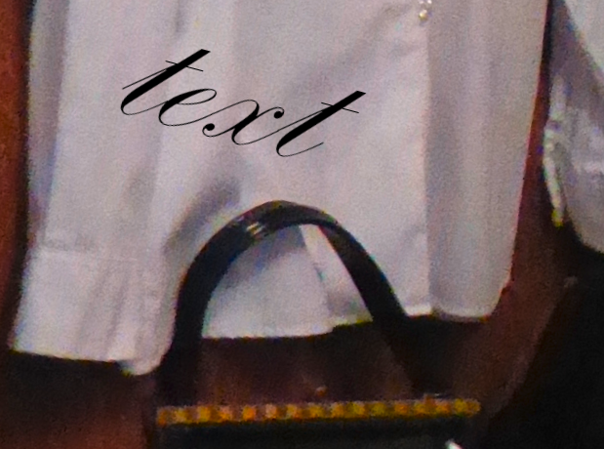
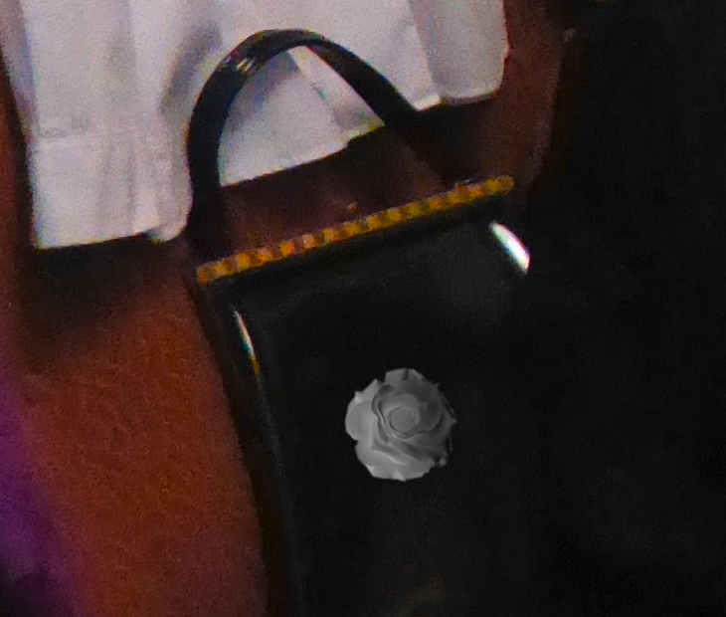
CGI
OverlayObject
OverlayText
Handwriting
DigitalPenDraw
handwriting
DigitalPenDraw
Overlay Text
Original
Overlay object

Slide 13
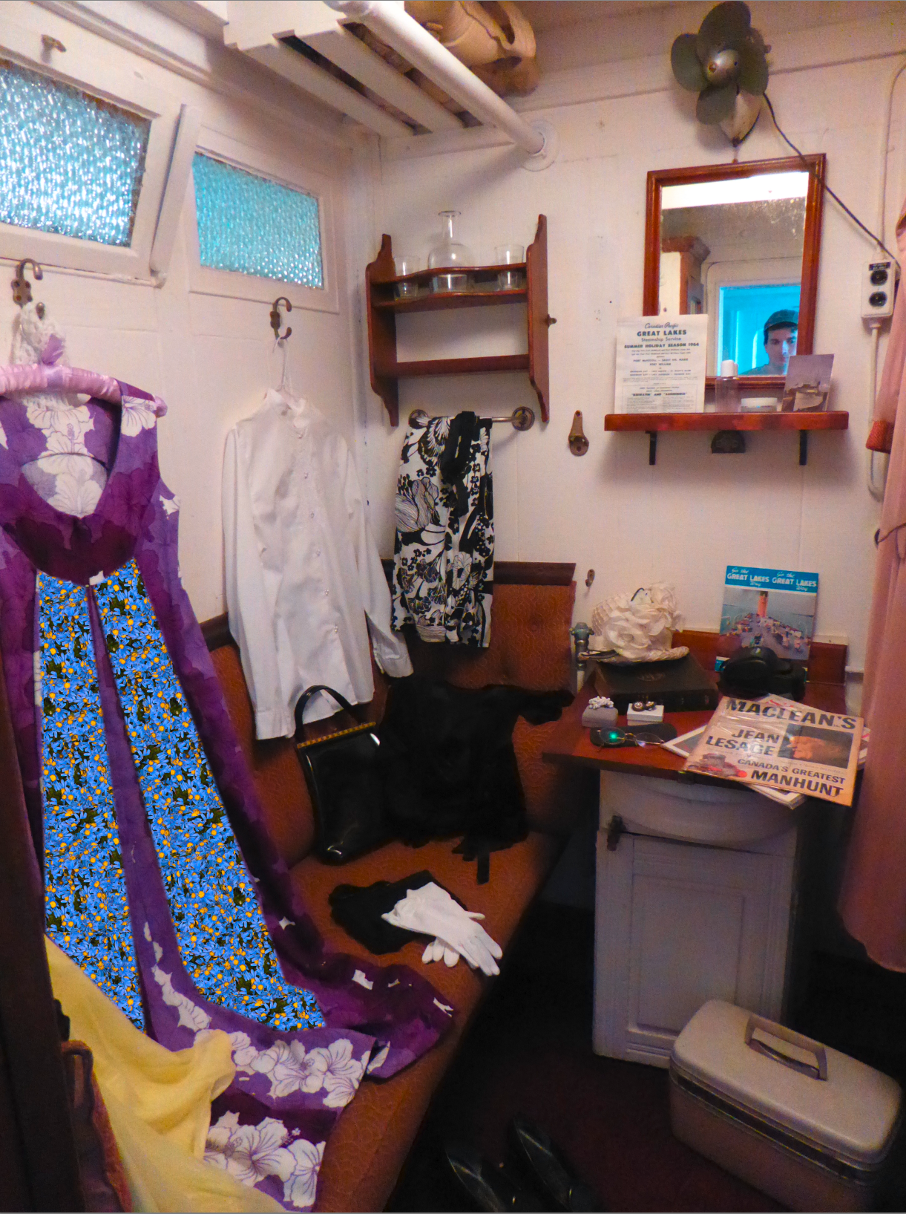
pattern
Fill an area with a CGI Pattern
original
with pattern

Slide 14

CGIFill
Fill is used to make a solid color area in an image.
original
Fill

Slide 15
Color
Vibrance
Hue
ColorBalance
ColorInterpolation
Saturation
Increase brightness
Increase vibrance
(brightness + saturation)
Increase saturation
Hue change
Decrease brightness

Slide 16
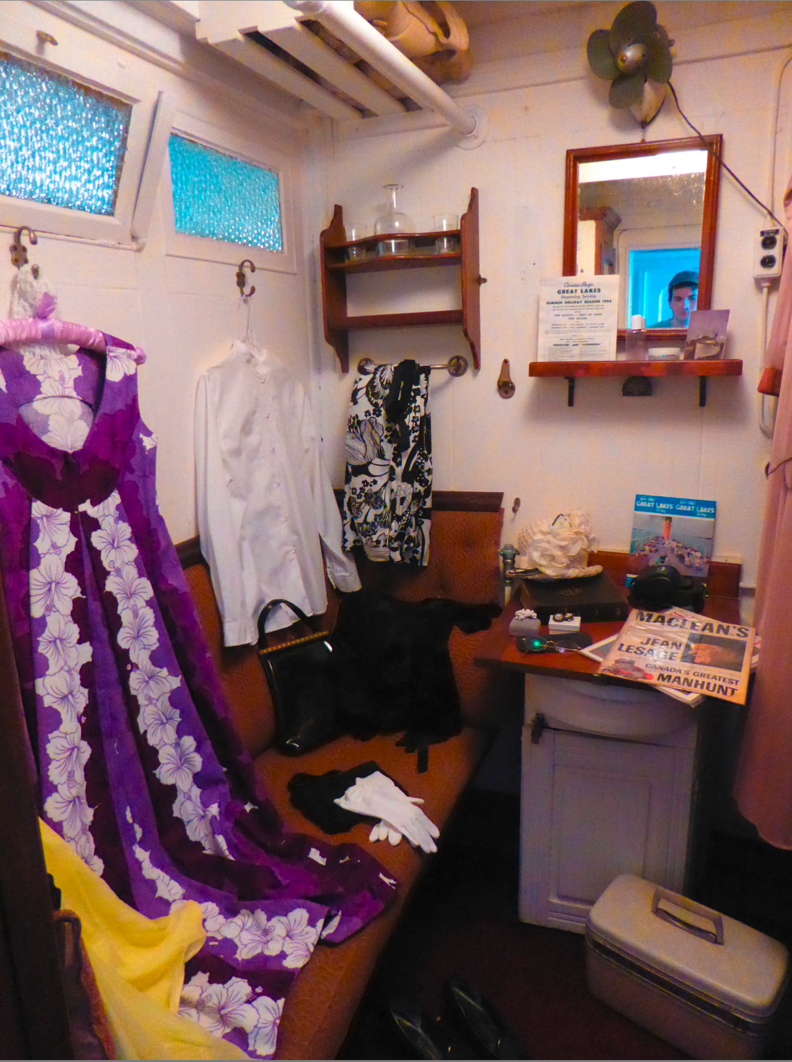
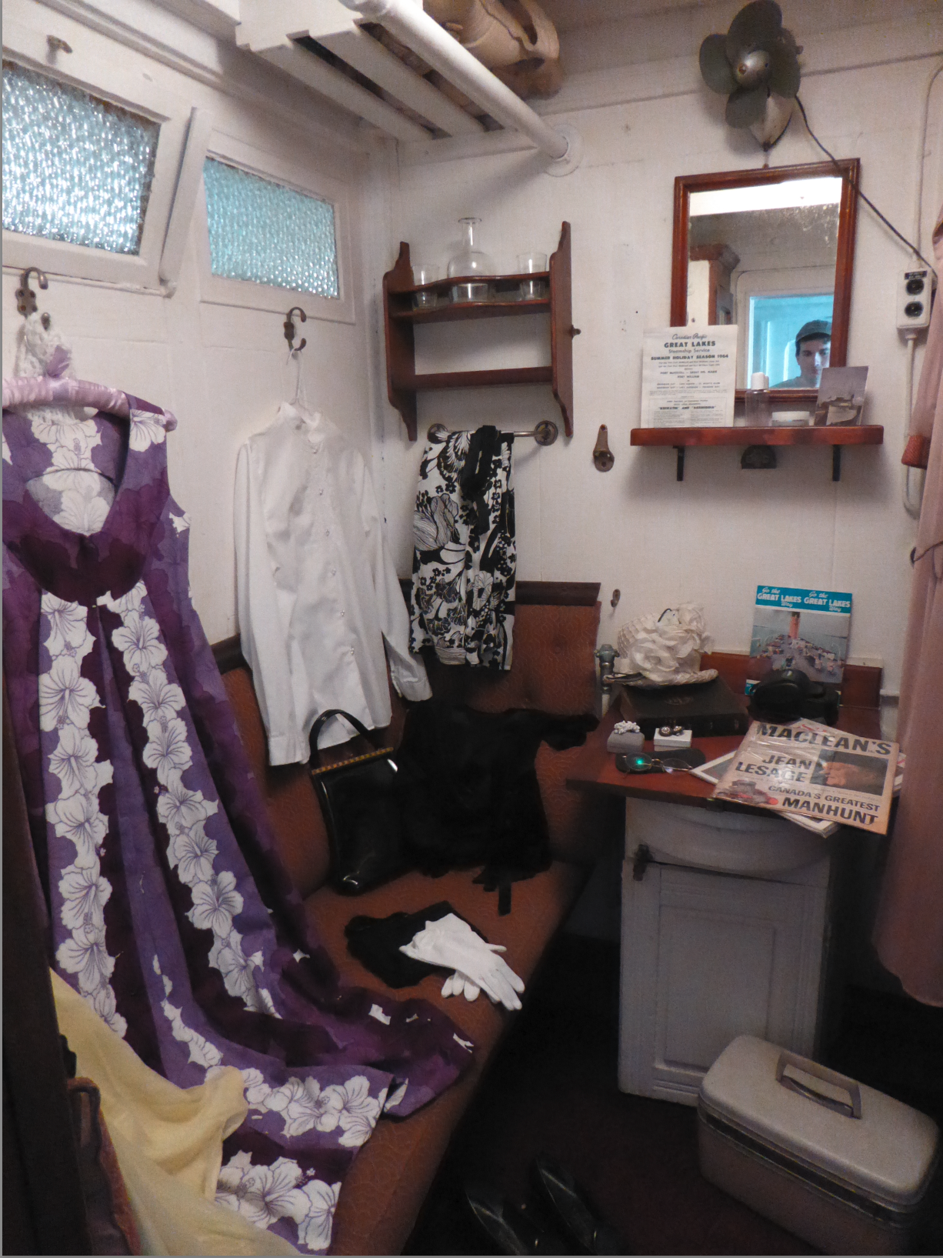
Vibrance
original
Vibrance increase
Vibrance decrease
Vibrance changes both the brightness and the saturation of the colors.

Slide 17
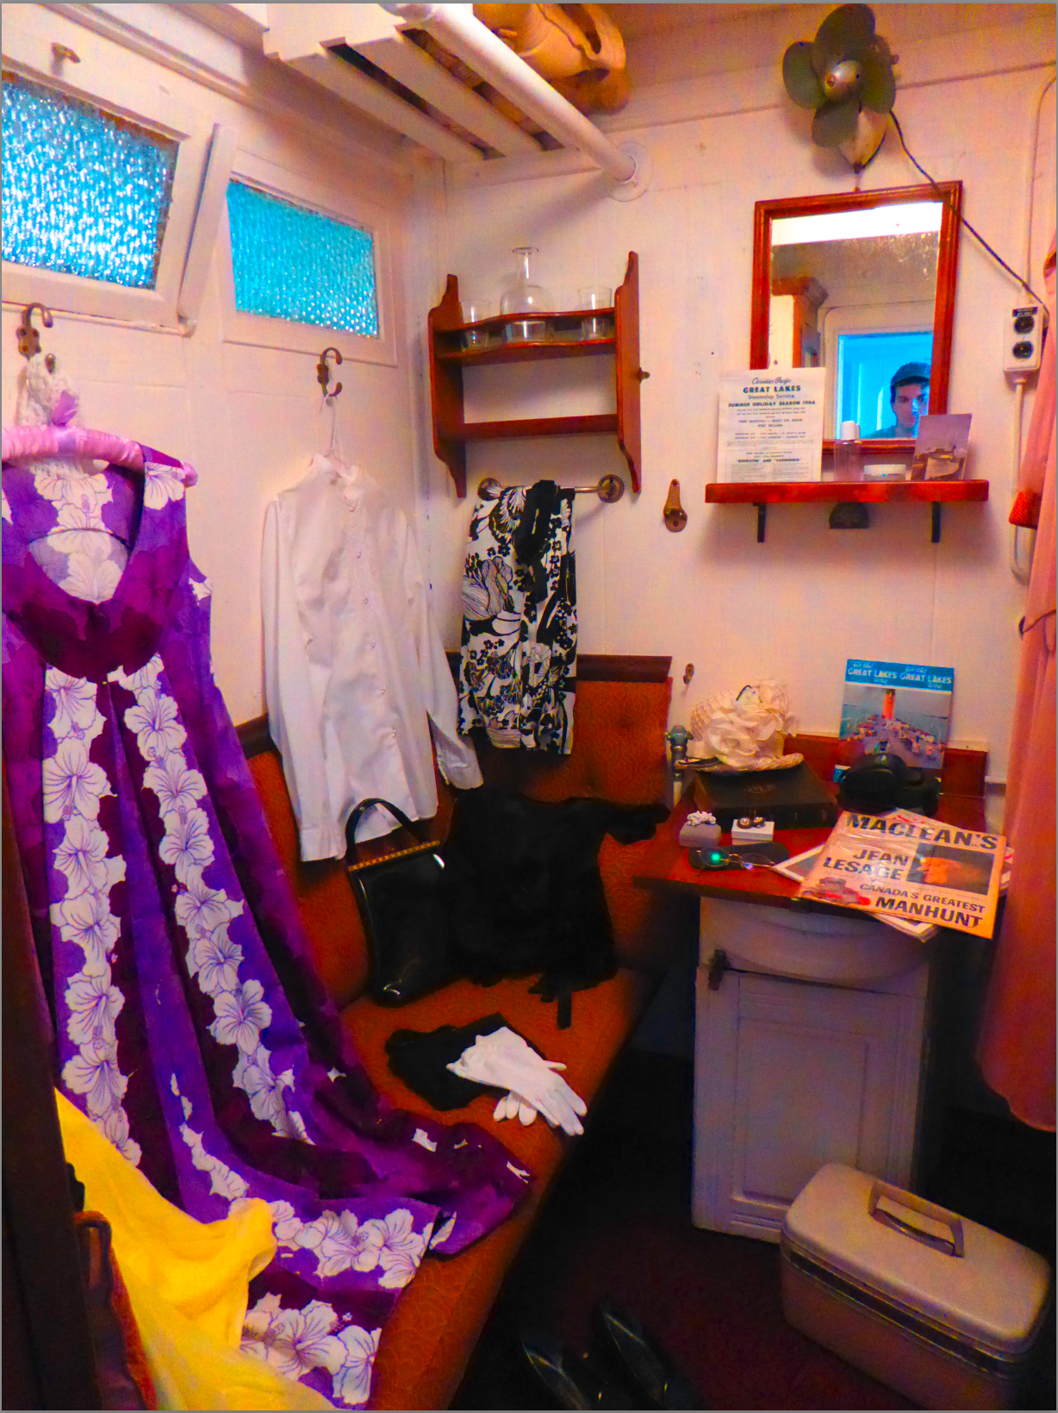
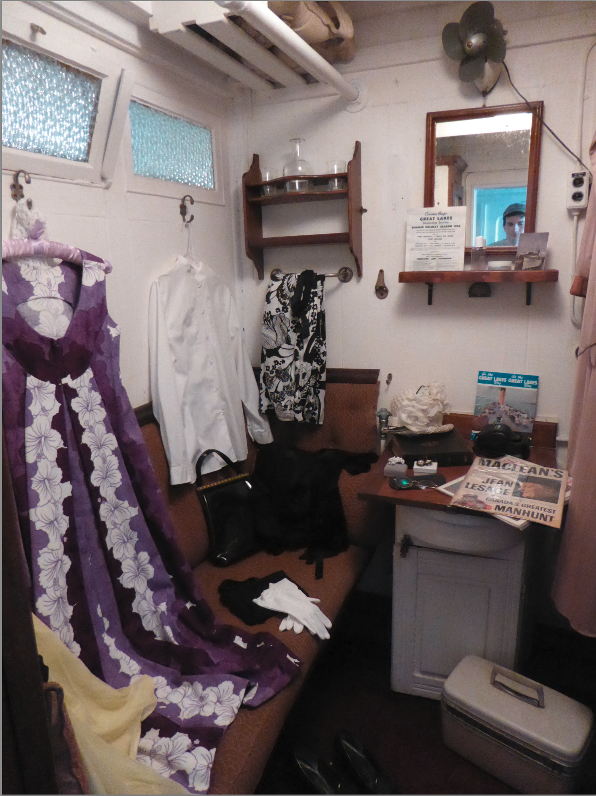
Saturation
original
Saturation increase
Saturation decrease

Slide 18
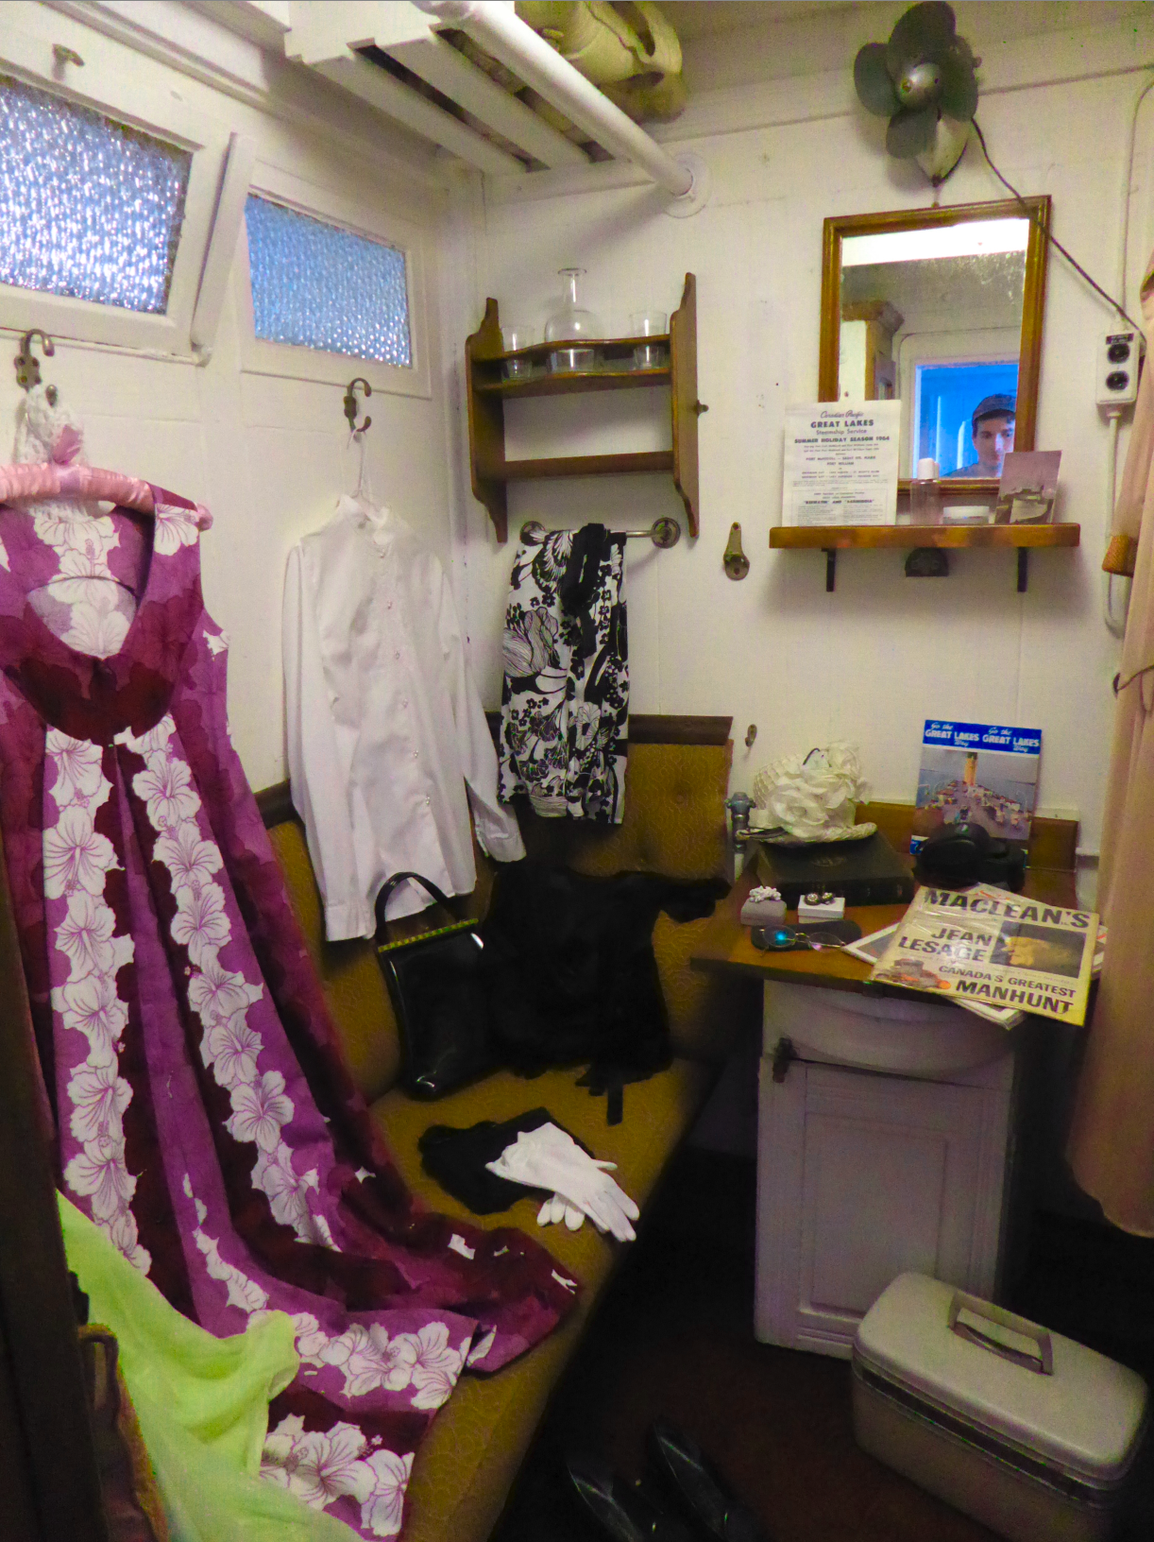
hue
Hue changes the name of the color that is referred to.
In the images below, the yellows have been shifted to appear more green.
original
Hue shift

Slide 19
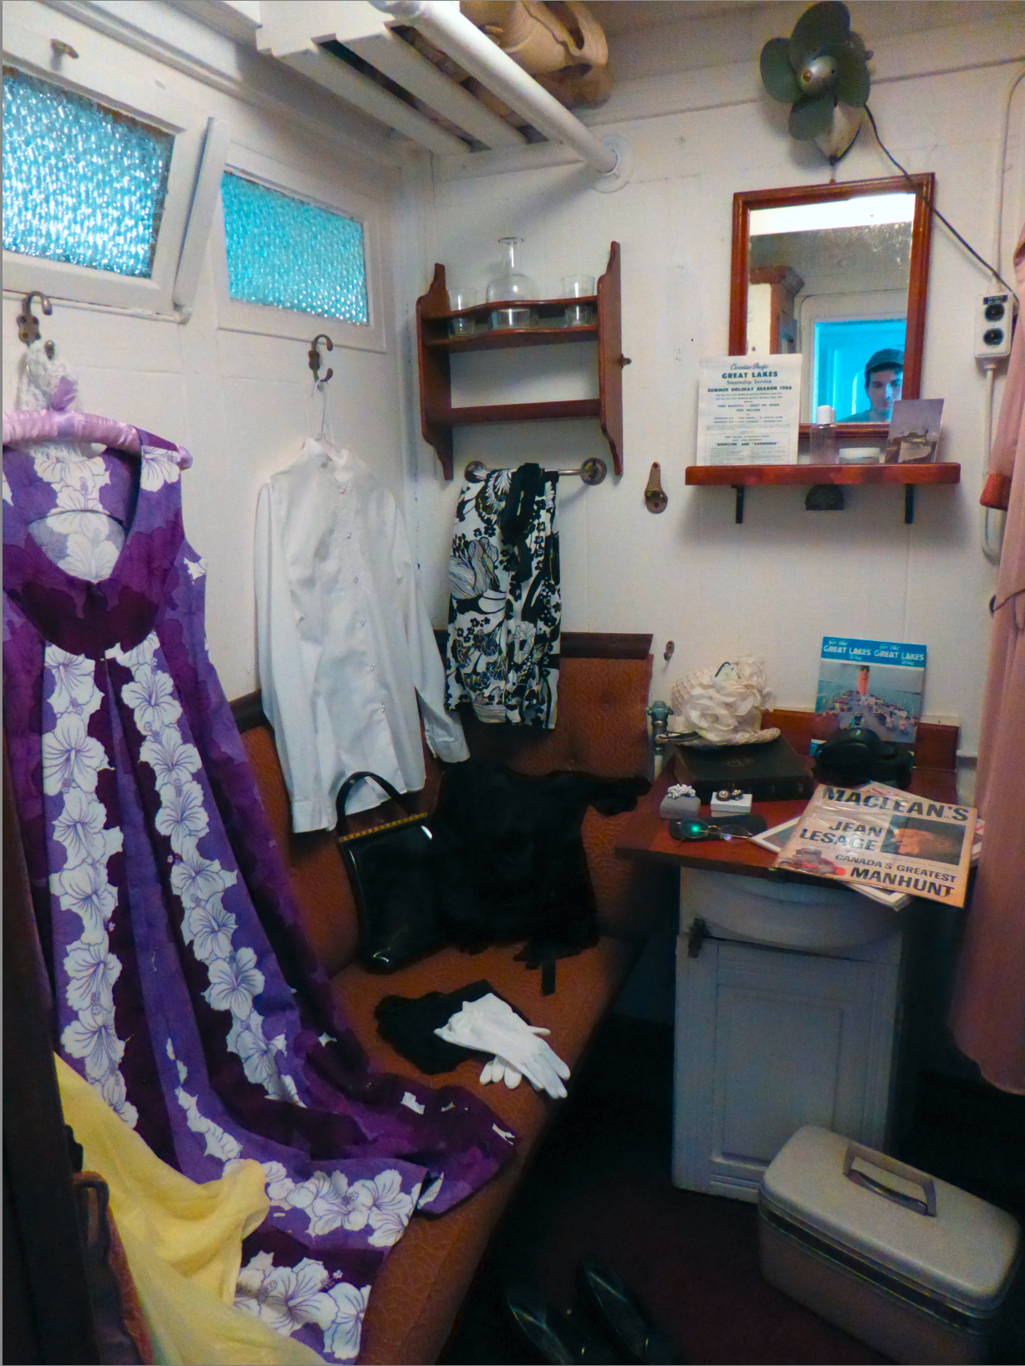
Color Balance
Color Balance can be done using many different tools, such as curves and levels, that have their own operation. If the intent of those tools is to do color balance, mark the link as Color Balance.
original
Color balance

Slide 20
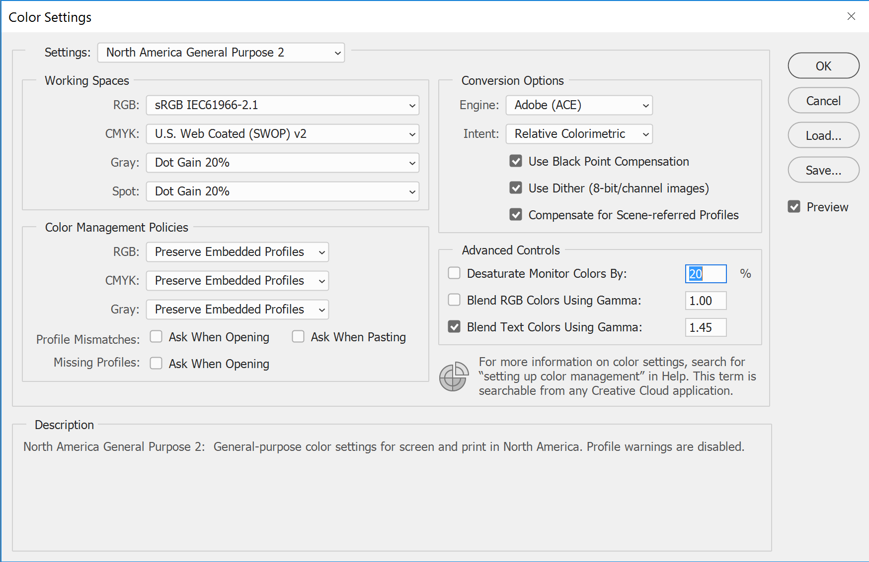
Interpolation
Color interpolation refers to changing the color space, or the way that the CFA was interpreted by the software. This may or may not result in a very visible change in the image.
This is an example of the different settings in Adobe Photoshop that could be changed to constitute an color interpolation link.

Slide 21
Filter
ConvolutionKernel
Blur
Smooth
Wavelet
Median
Median Smoothing
Gaussian
Radial
Tilt Shift
Motion
Other
Sharpening
CameraRawFilter
CreativeFilter
AddNoise
Salt-pepper
Shot
Uniform
Random
Gaussian
Periodic
Other

Slide 22
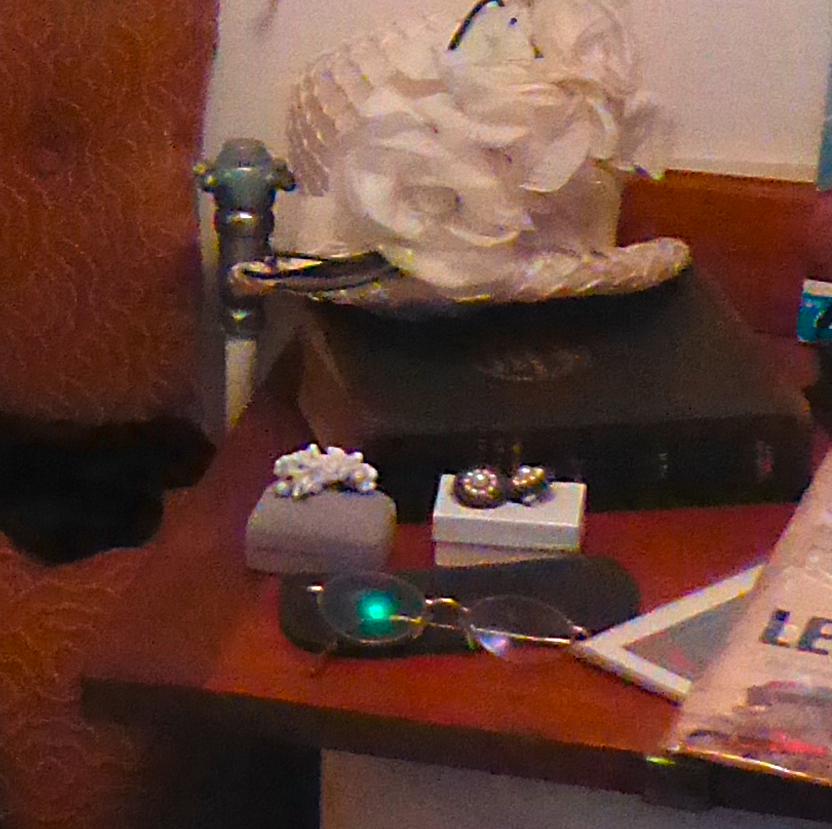
Sharpening
Sharpening makes edges more prominent by creating larger differences between the pixels based on a type of edge detection algorithm
original
Sharpened

Slide 23
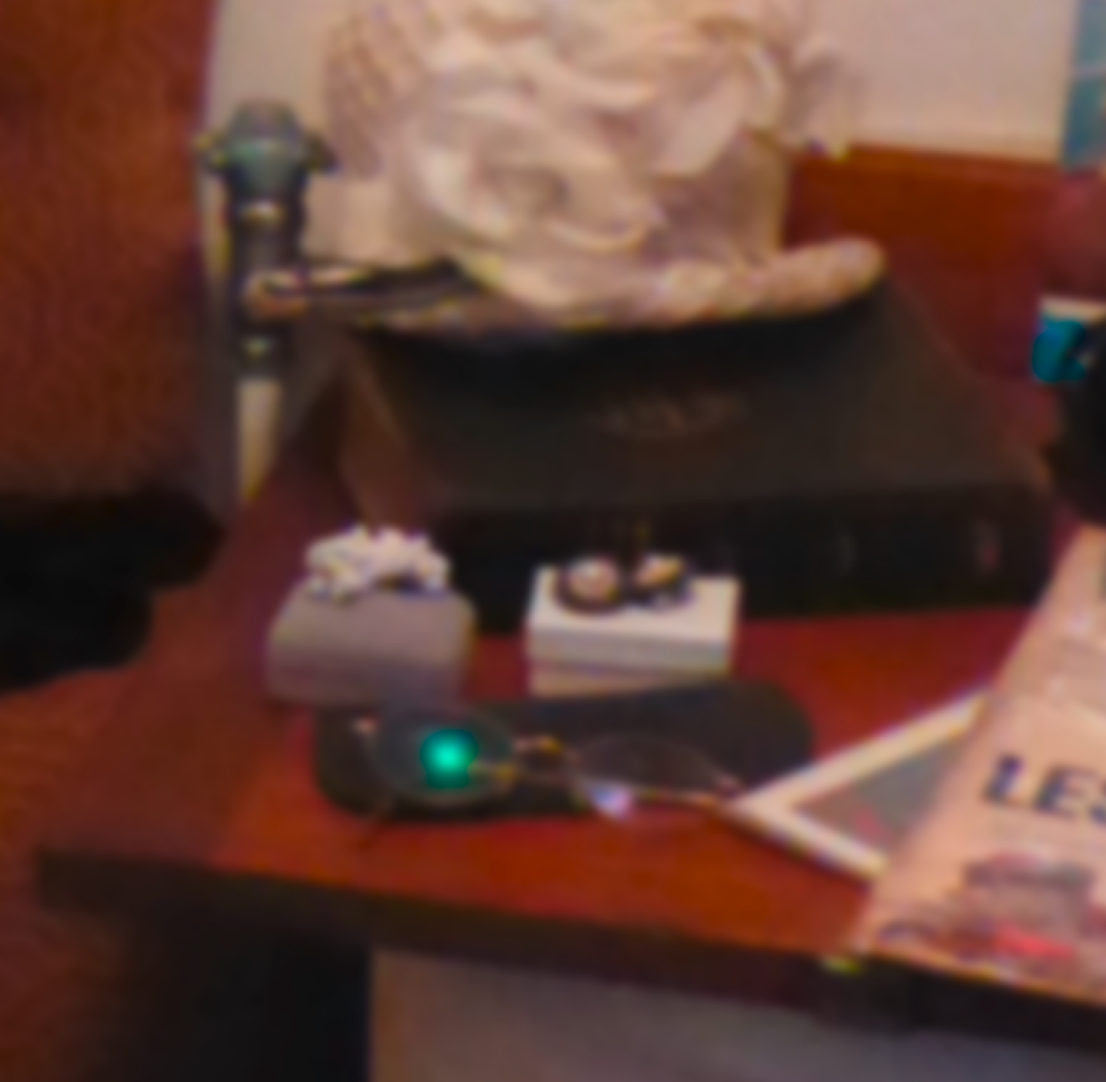
Blur
Blur makes pixels more like each other to create a variety of effects.
Blur should be used for any type of blur other than Motion Blur.
Blur can also be documented more specifically by using Filter Convolution Kernel
original
Blur (Gaussian)

Slide 24
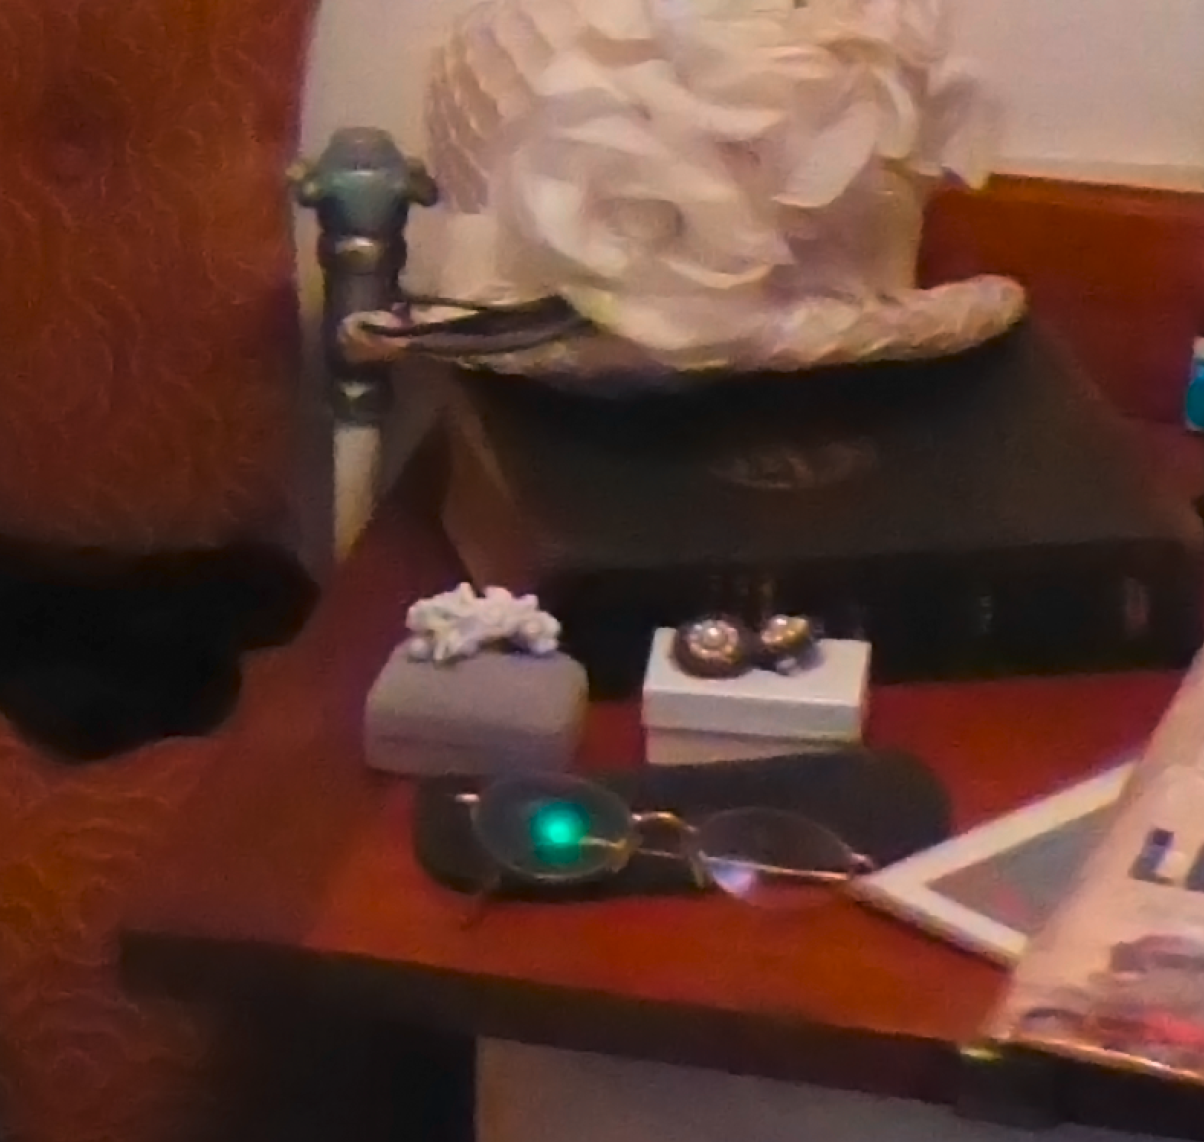
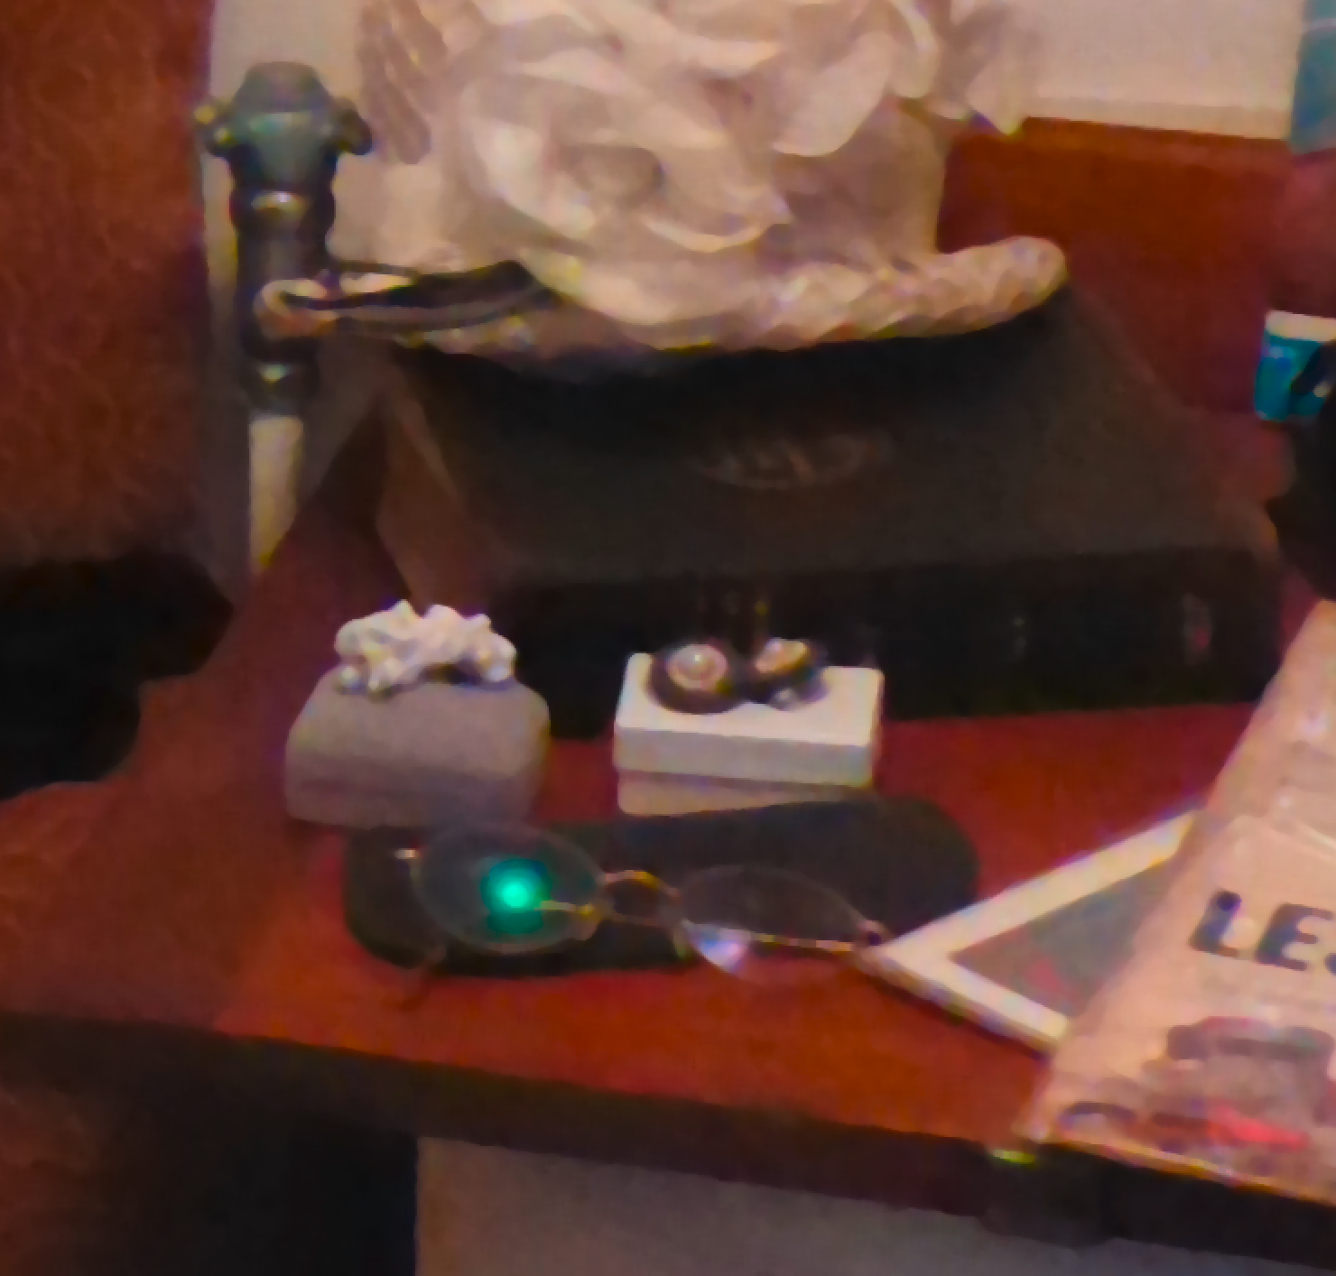
Smoothing and Median Filtering
Noise reduction
Making neighboring pixels more alike
Median Filtering can be done for laundering purpose
original
Smoothing
Median

Slide 25
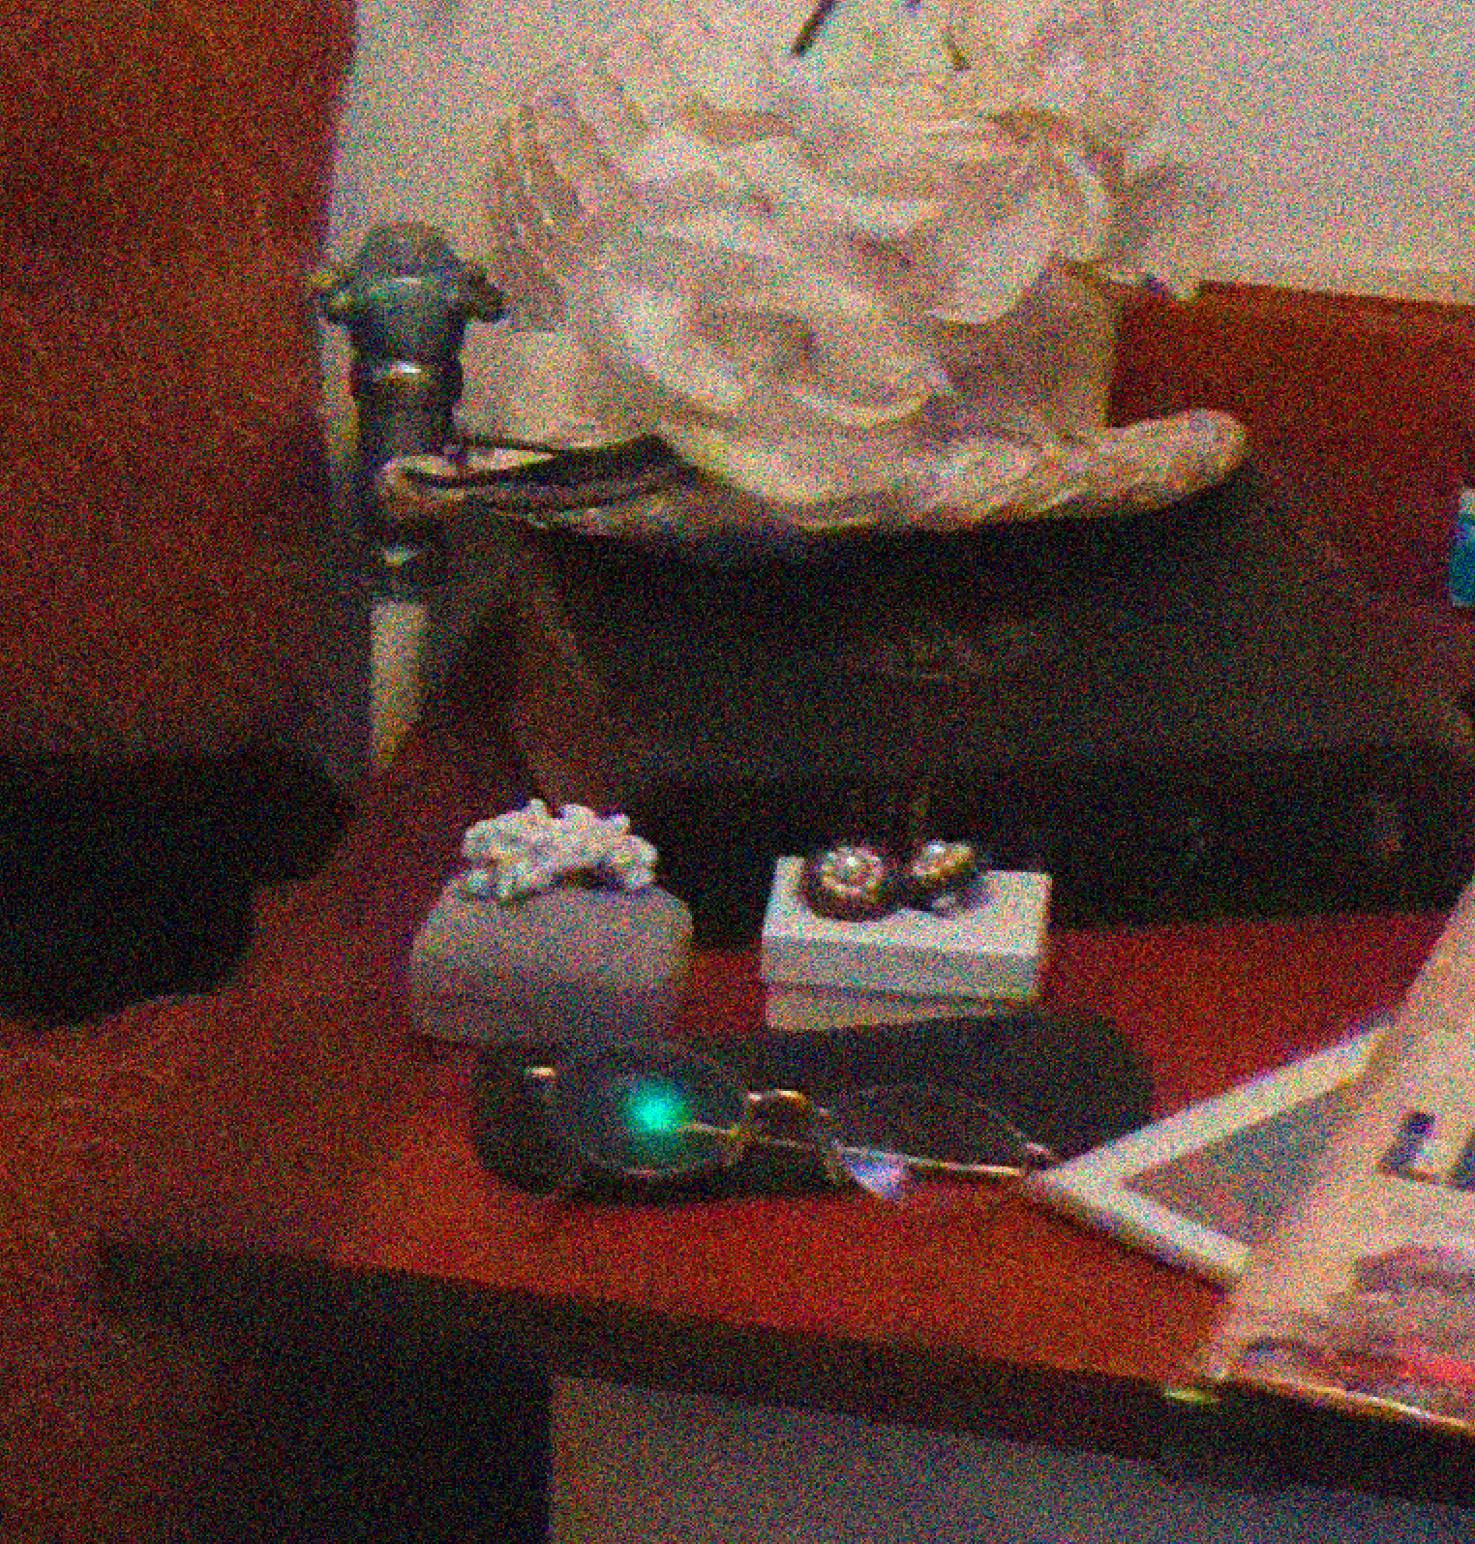
Add Noise
Use Add noise for all noise additions other than PRNU noise
original
Add noise (Gaussian)

Slide 26

Creation
CreationFilterGT
original
Oil paint filter

Slide 27
Intensity
Exposure
Contrast
Levels
Normalization
Luminosity
Curves

Slide 28
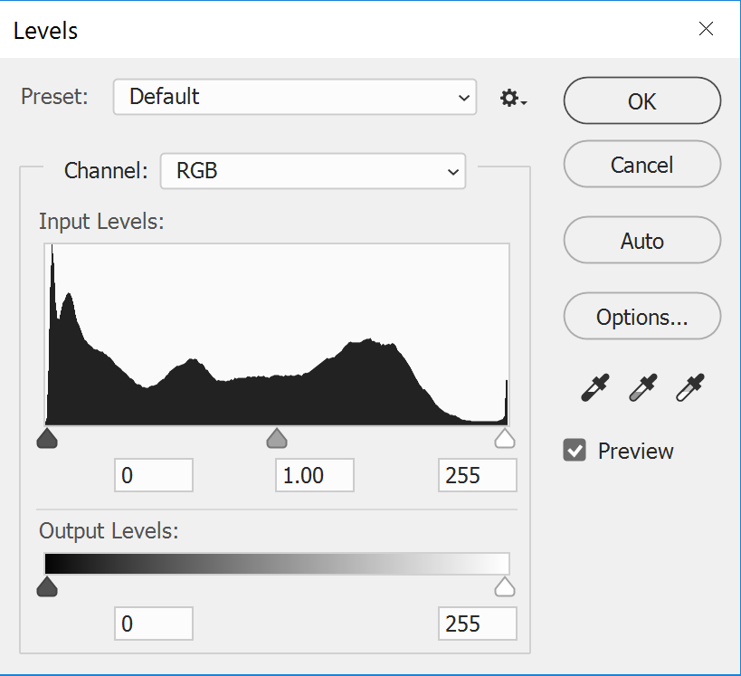
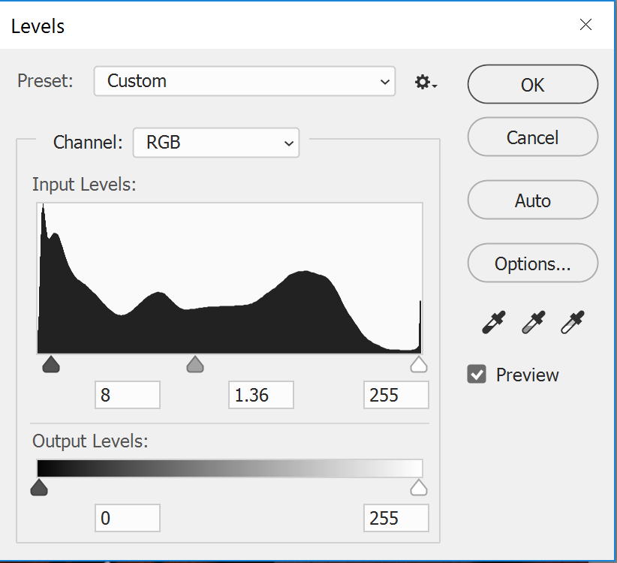
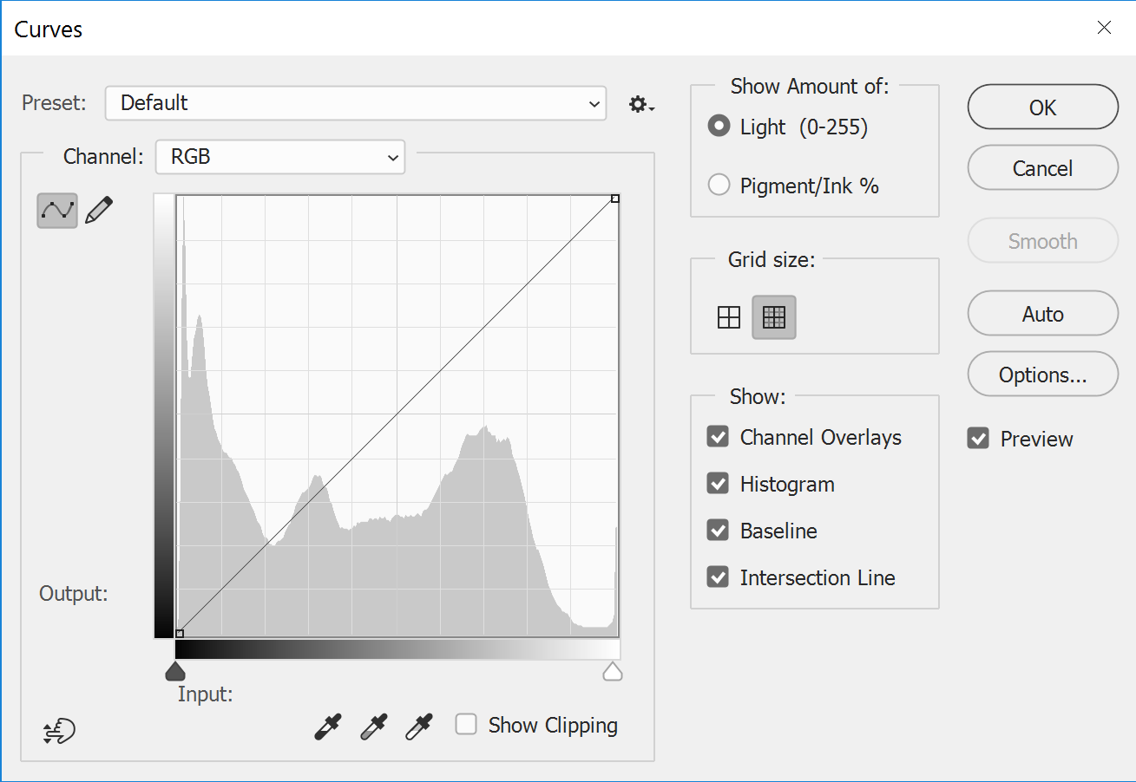
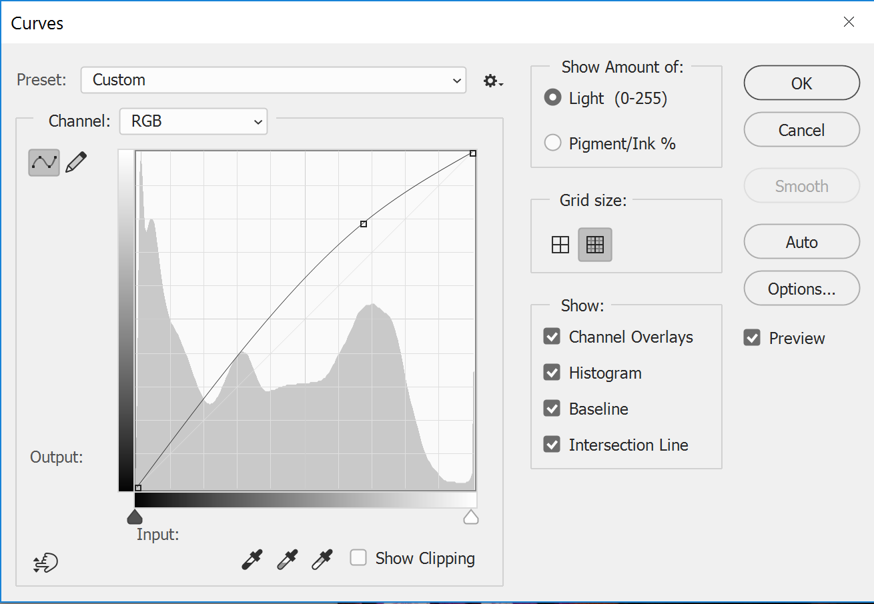

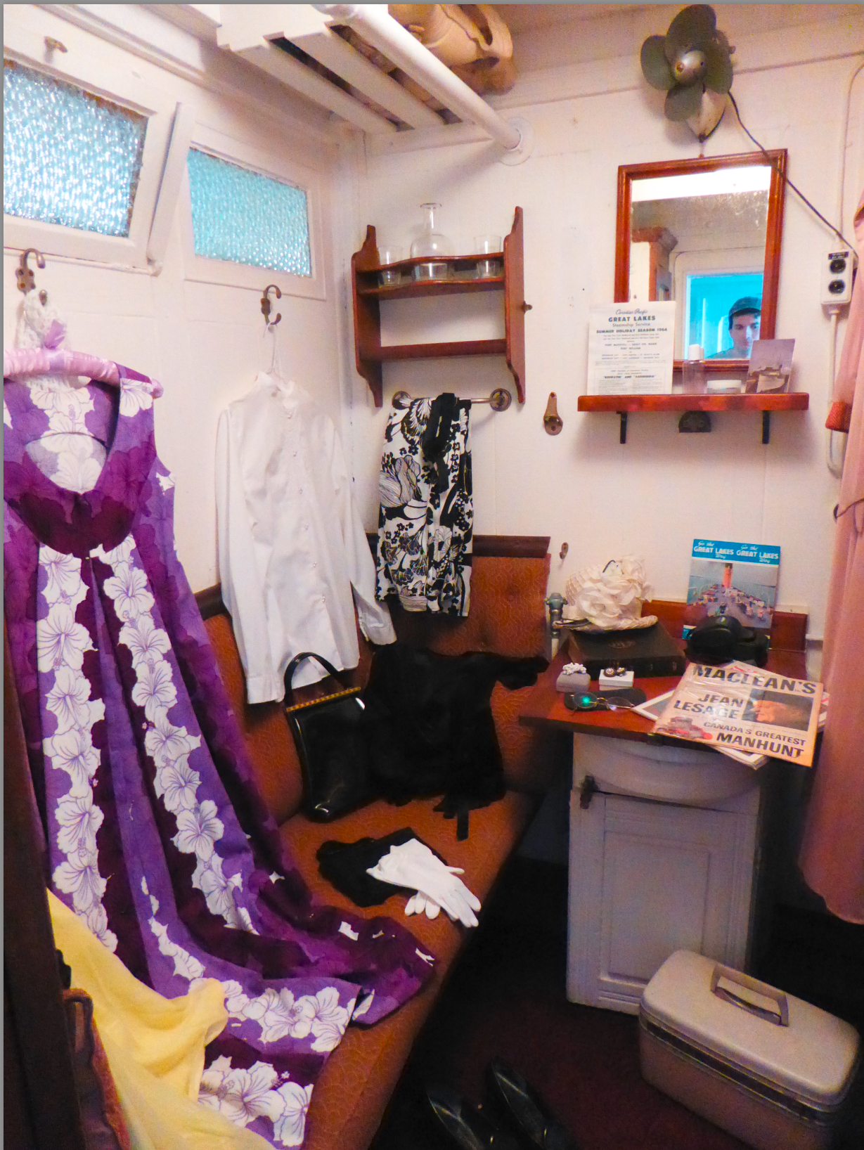
Levels & Curves
Auto levels
original
Auto Curves

Slide 29
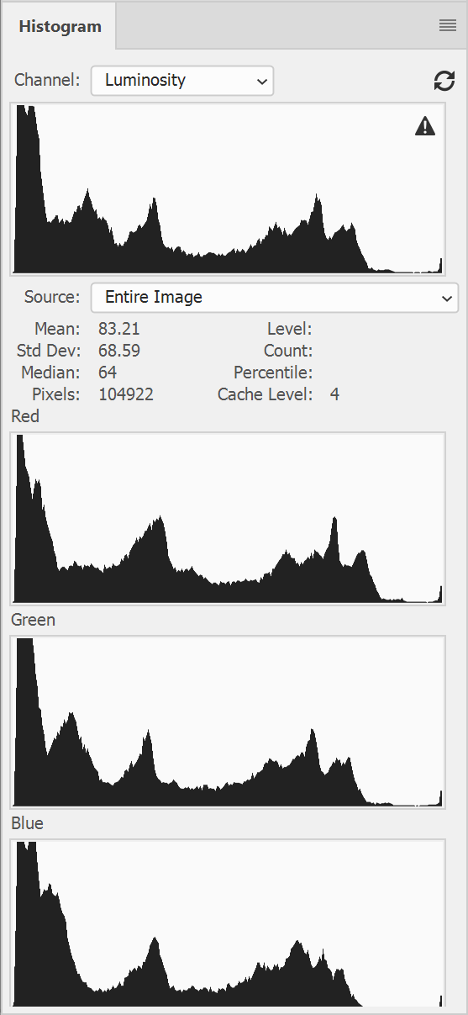
Levels & Curves and Color
By changing the histogram in the separate channels, not only the intensity can be adjusted, but the color will be shifted as well.
See journal for examples of curves and levels: https://medifor.rankone.io/journal/3478
0 - black
255- white
0 - cyan
255- red
0 - magenta
255- green
0 - yellow
255- blue

Slide 30
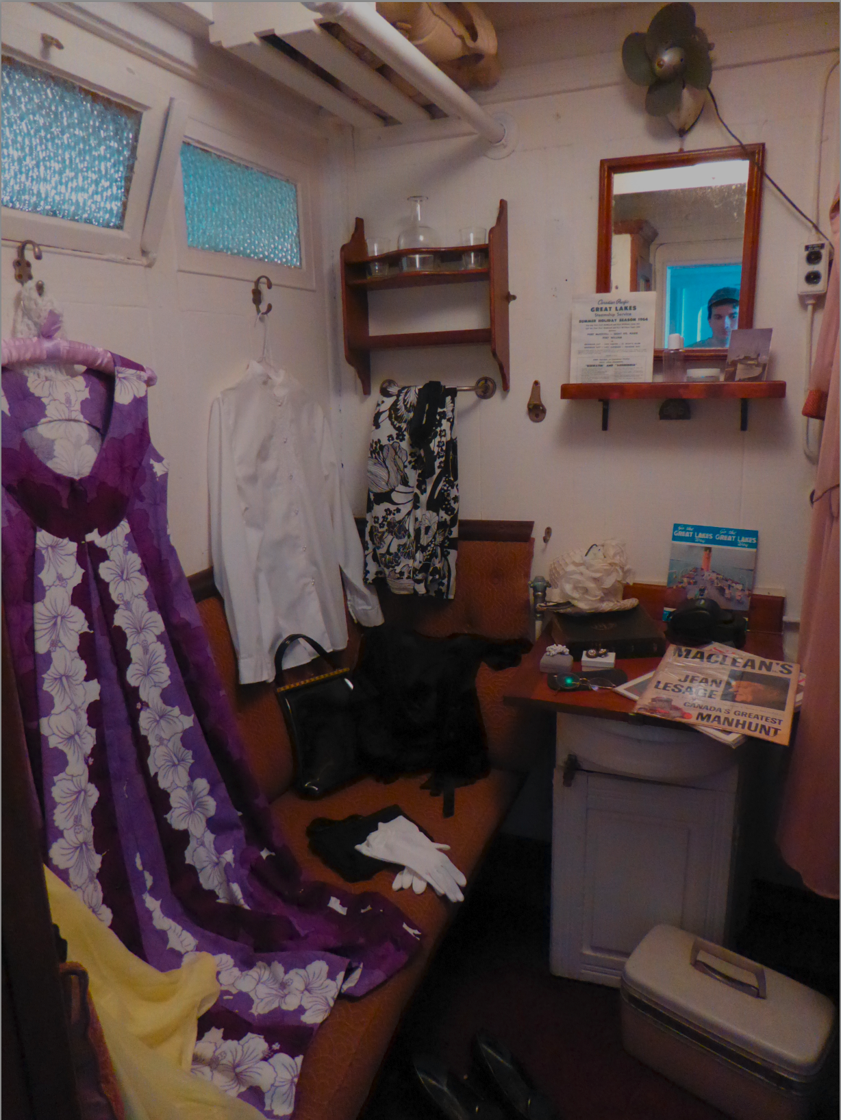
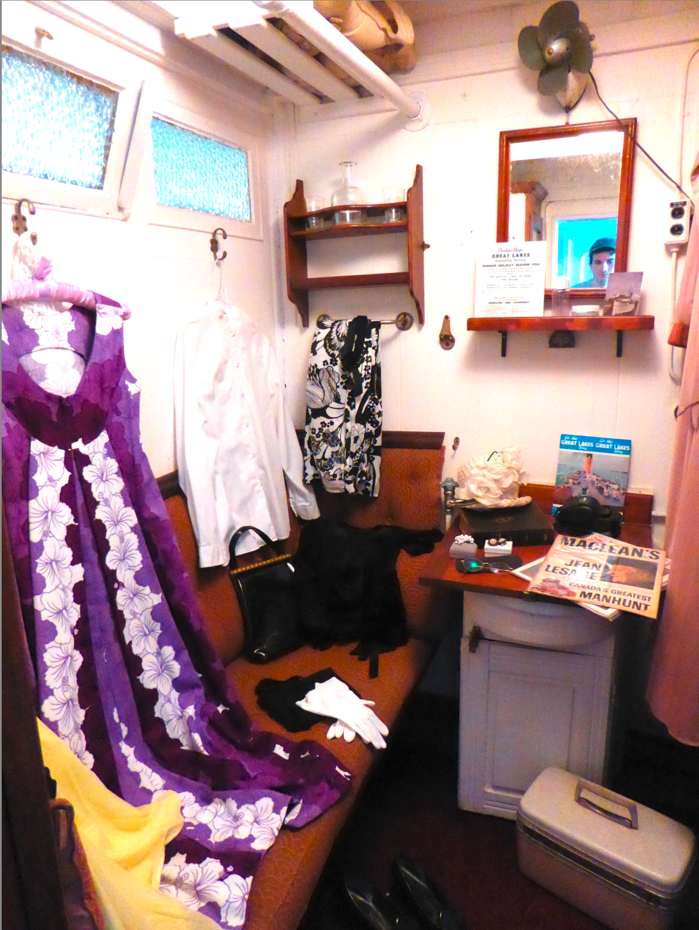
Exposure
Mimics the result of adding more or less light in Exposure Values in capture.
Exposure -decrease
original
Exposure - increase

Slide 31
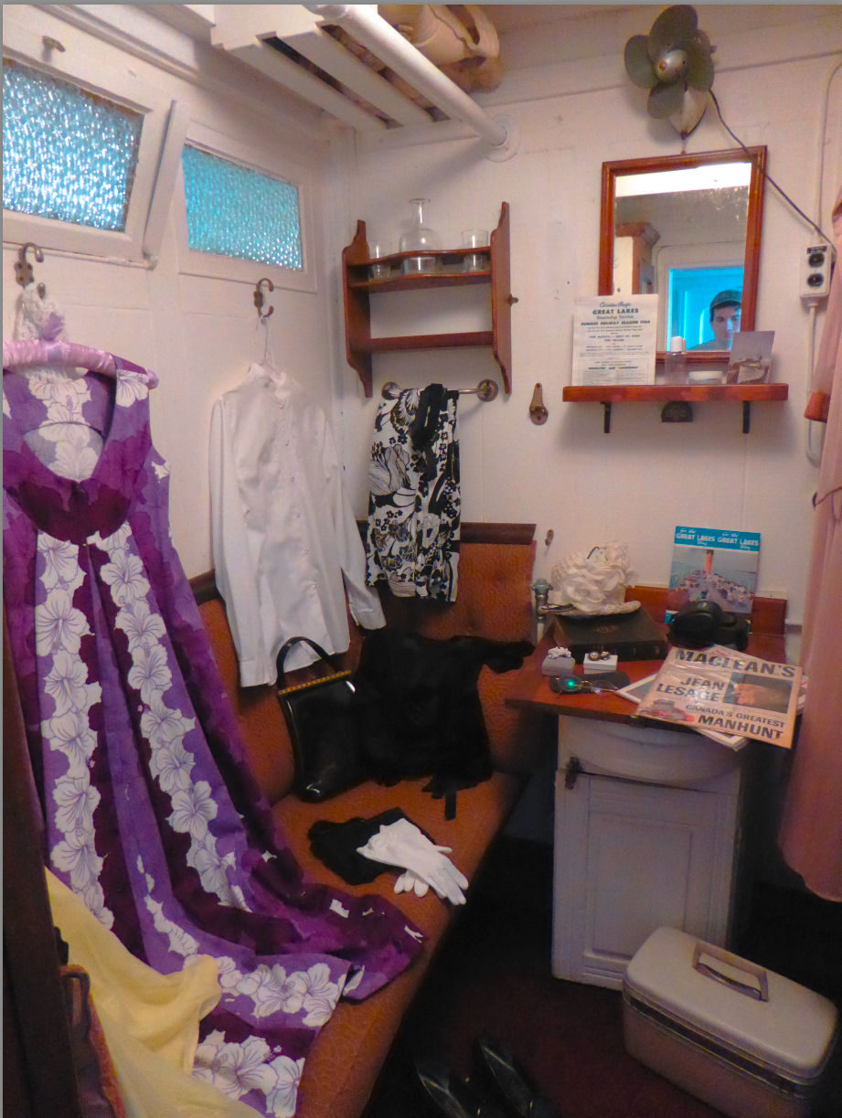
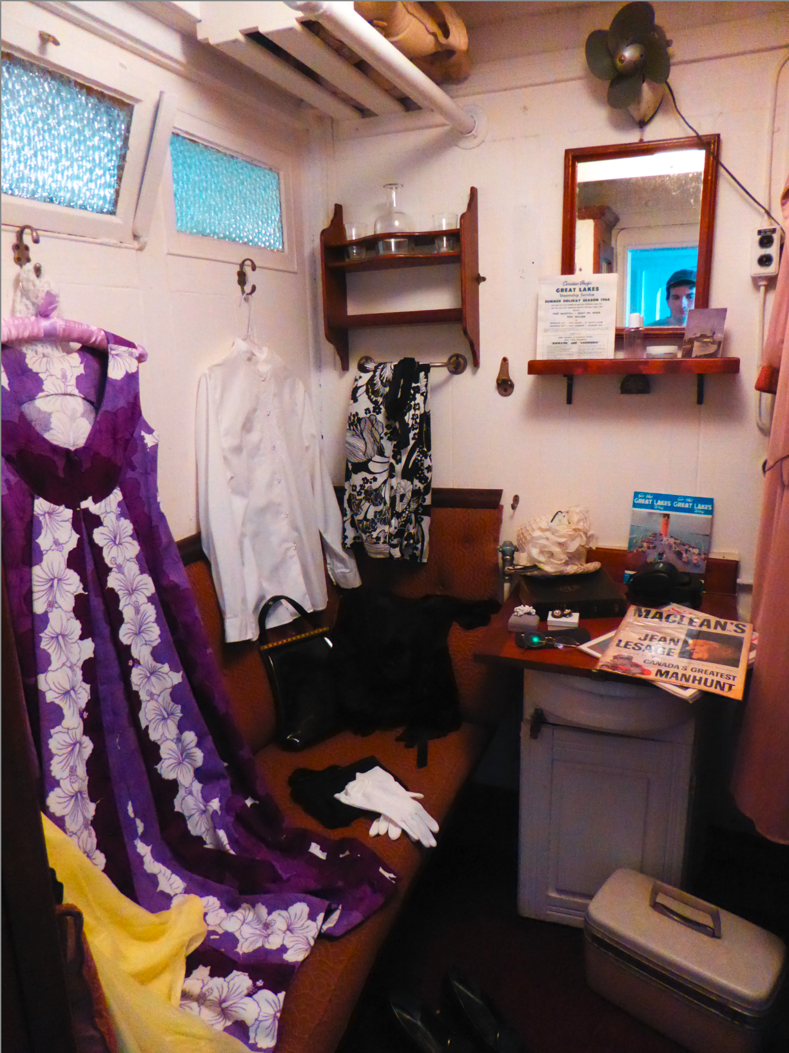
Contrast
When you change the relationship between the intensity of the pixels.
Increase contrast: creates larger differences between the brightest and darkest pixels.
Decrease contrast: creates smaller differences between the brightest and darkest pixels.
Contrast -decrease
original
Contrast - increase

Slide 32
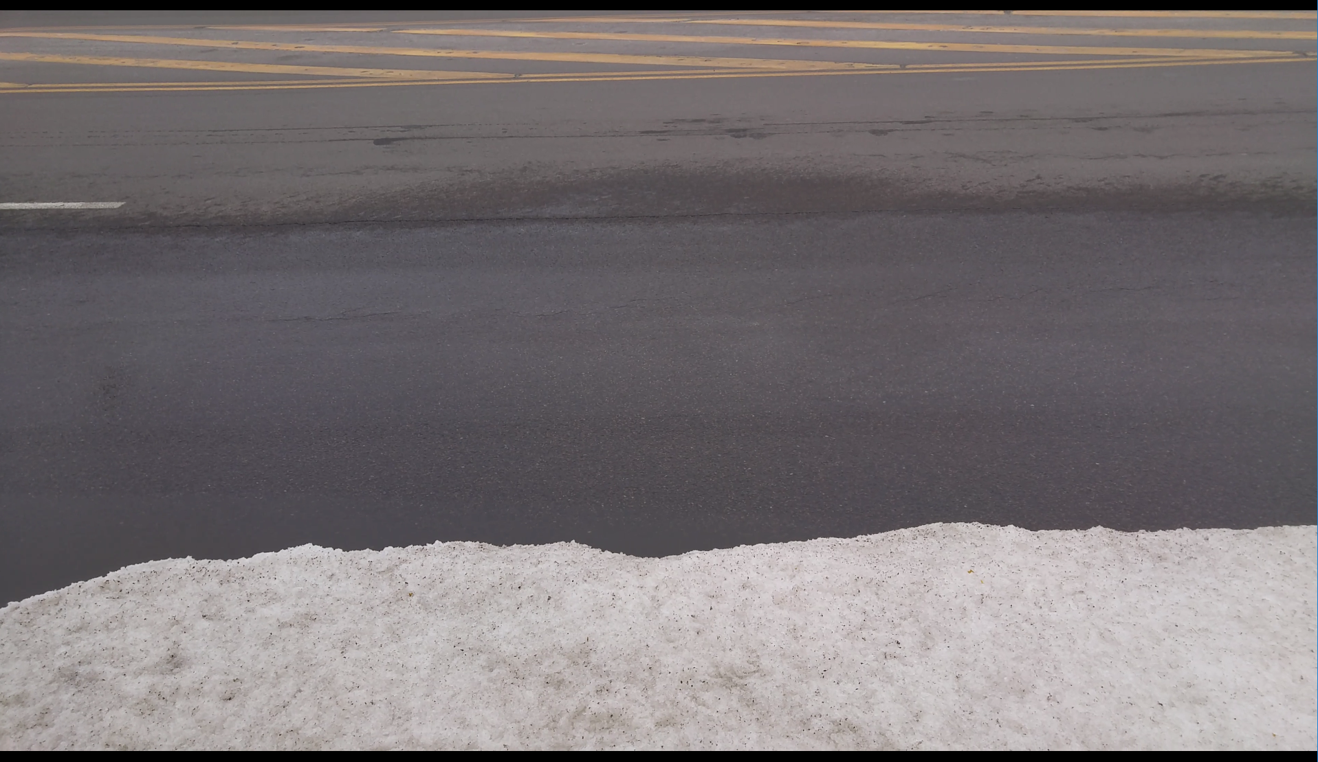
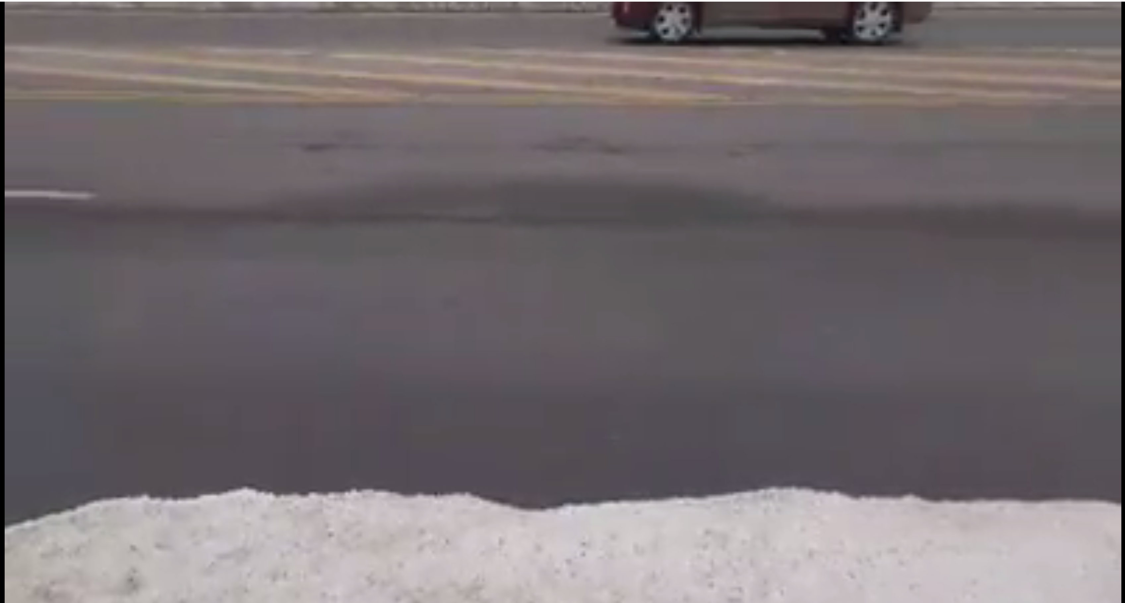
Laundering
SocialMedia
Before social media upload
After social media upload

Slide 33
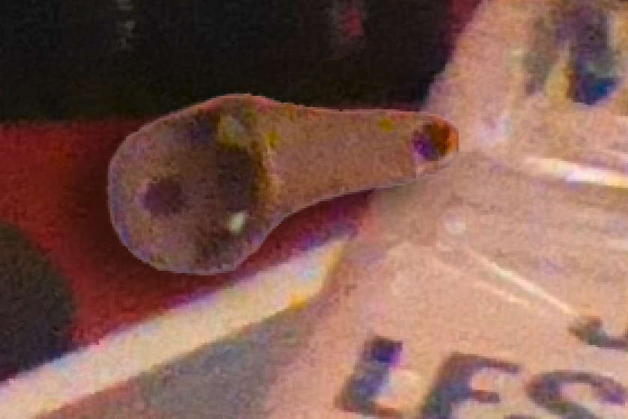
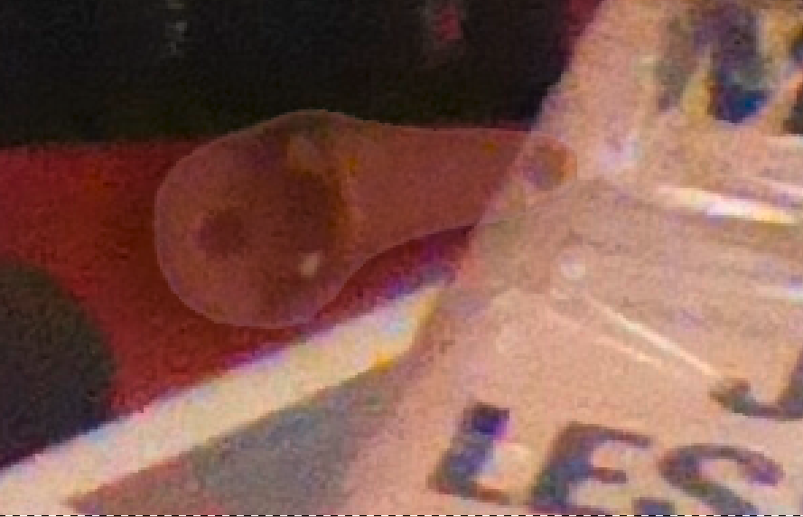
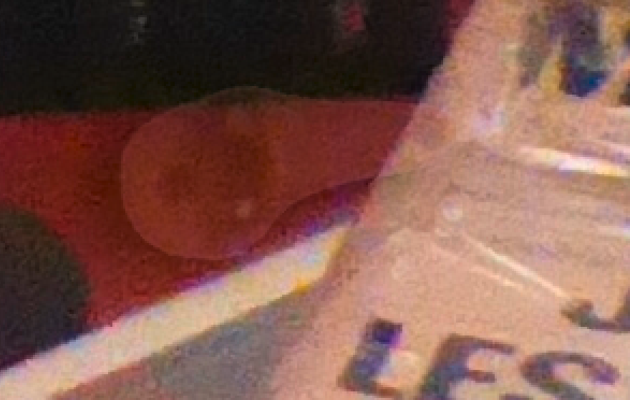
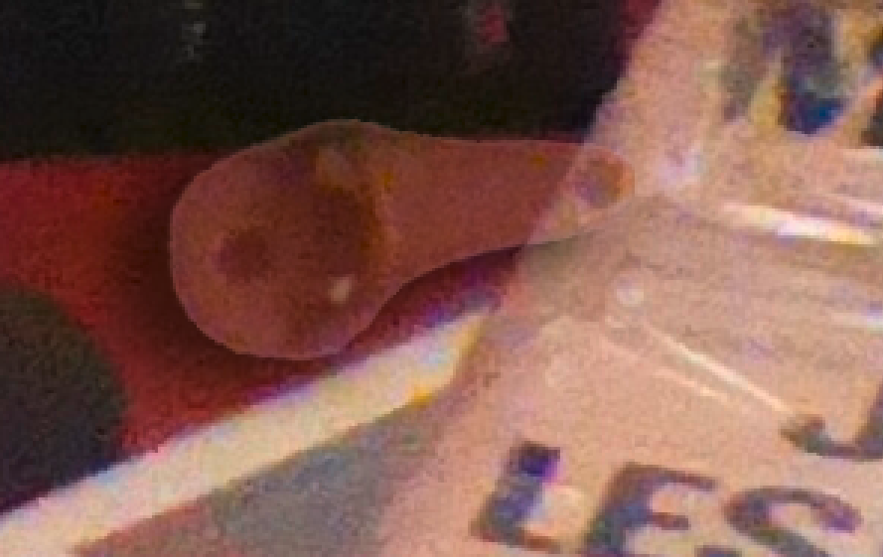
Layer
Opacity
Fill
Fill 100% Opacity 100%
Fill 100% Opacity 50%
Fill 50% Opacity 50%
Fill 50% Opacity 100%

Slide 34
Output
BMP
TIF
DNG
Copy
PNG
JPG
Most operations do not allow for change in file type, use these operations to do so.

Slide 35
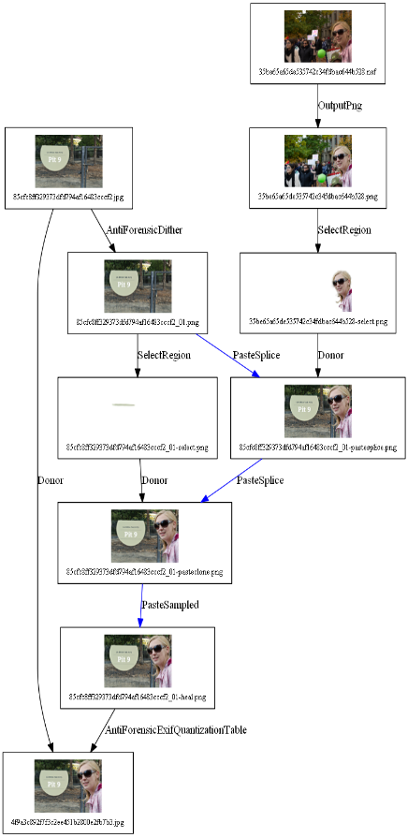
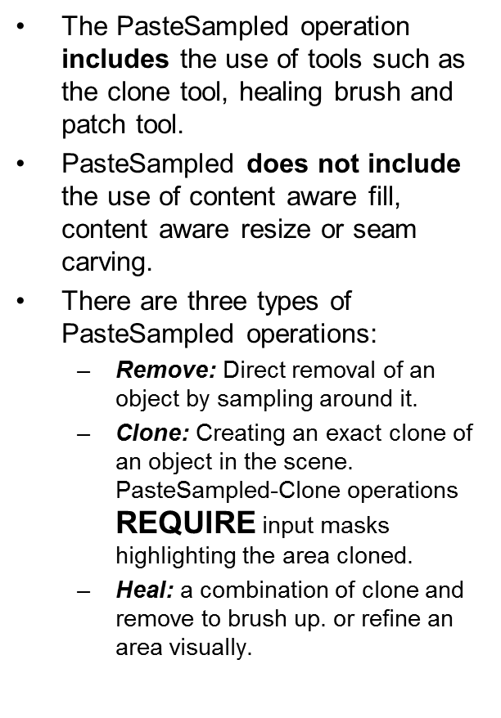
Paste
Splice
Splice
Sampled
ContentAwareFill
Copy Paste Type
Base Image
Donor Image
Sampled
Stamp/Heal/Blend Type
Donor selection
Selection to clone from base
Donor paste splice
Donor paste splice to clone
Content aware Fill

Slide 36
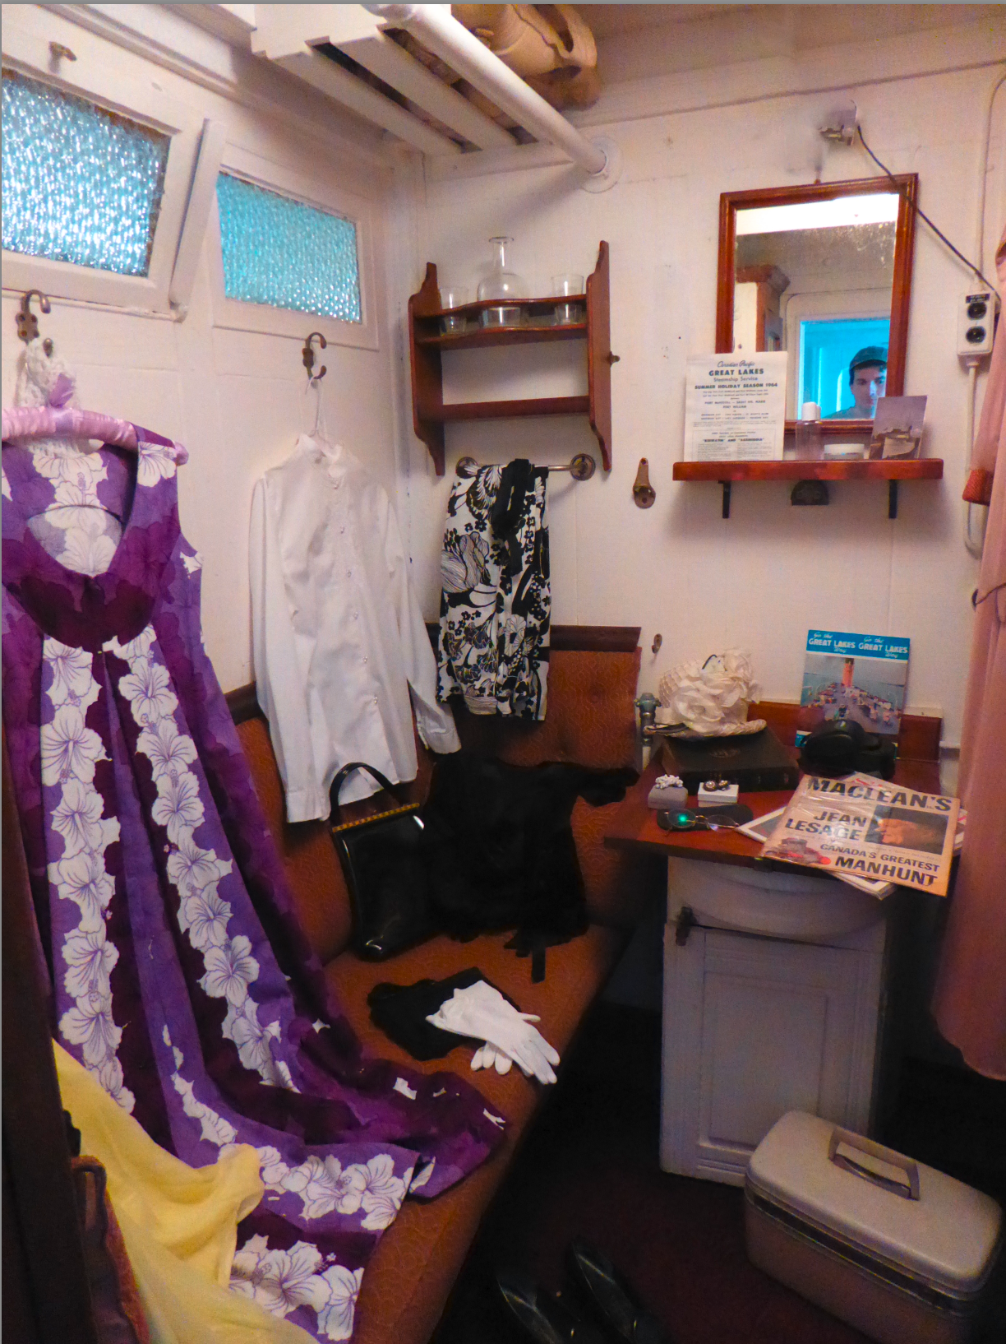
Content aware fill
Content aware Fill to remove
Content aware fill will take a selection of pixels and fill it with pixels that are similar to those around it.
original
content aware fill -remove

Slide 37
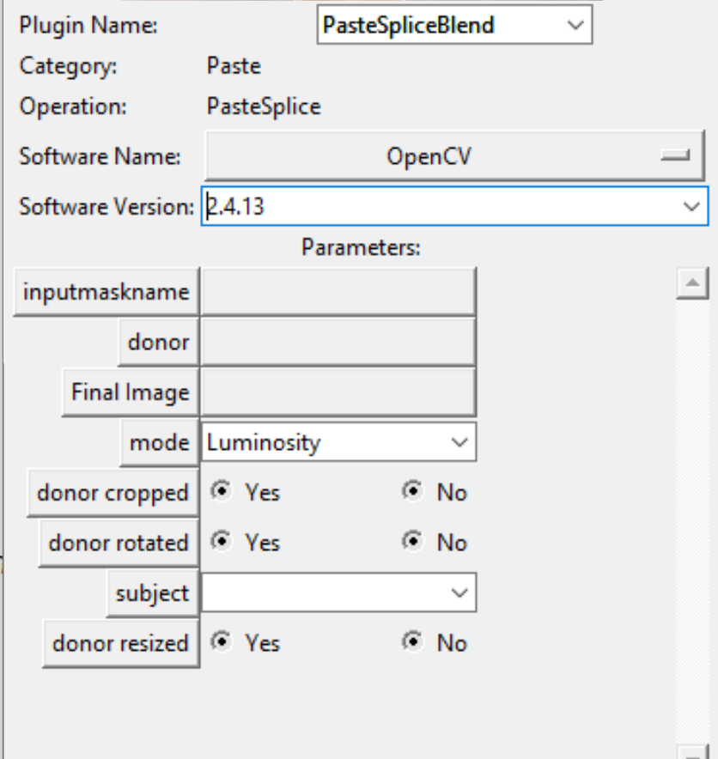
Paste Splice Blend: Workflow with a donor image
Use Next with Filter to open the dialog box
Base
Donor
Paste Mask
Alpha channel
Paste Splice
Select Region
Save the placement of the donor in the image before blending
Final Placement and blend
Alpha channel
When to use it:
When an object being added will be in its final state in a blended/lower opacity mode

Slide 38
Journaling Cloning
Paste splice vs Paste sampling

Slide 39
Workflow Overview
Preferred Method: Select Region -> Paste Splice
Select Region
Paste splice:
Create a selection
Do changes to that selection (resize, rotate, (if must crop)
Paste selection
Use paste splice if you are copying and pasting.
Paste Splice
Donor
1
2
3

Slide 40
Secondary Workflow
Alternative Method: Paste Sampled with Input Mask
Paste sampled:
Create a target point
Use your sampling tool (patch, clone, healing brushes, rubber stamps etc.)
Create an input mask that summarizes the area that you used. The more accurate the better.
If you can create an accurate mask, use paste splice regardless of tool you use.
Use paste sampled for cloning if you cannot create an exact input mask or select region because of advanced or algorithmic blending.
Input Mask
Input Mask
Paste Sampled

Slide 41

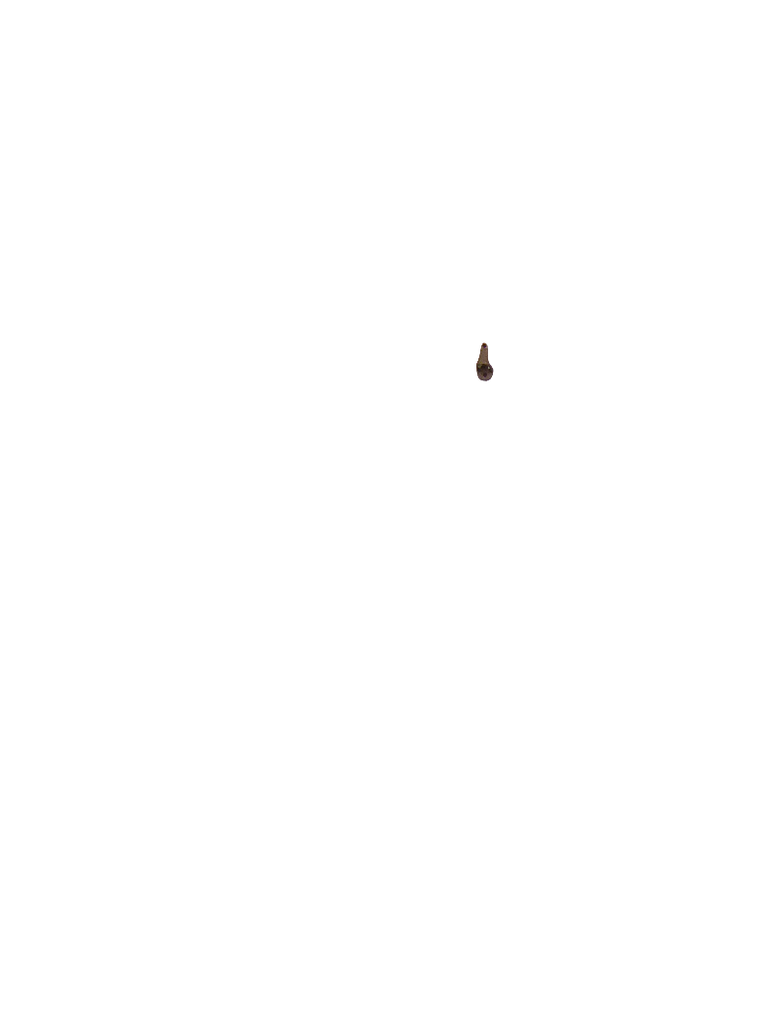
Paste sampled -clone
Notice
Change in luminance
Exact orientation and size
Also the change mask will show that the edges are blurry and larger than input mask
Clone
Input mask: selection of the original area, saved with the background being an alpha channel

Slide 42

Paste splice -clone
Notice:
Change in size and orientation
No change in color or intensity
Might be some cropping of selected region
Clone
Select Region: selection of the original area, saved with the background being an alpha channel

Slide 43
Summary for Journaling Semantic Clones
Paste Splice
Paste Sampled
When you can create a selection
When it is a straightforward copy and paste
When tools allow for creating separate steps
When you can only create a general selection
When there is blending or computer generated content to fill in the unknowns to create a better visual effect
When the sampling tool does not let you choose where sampling is from.

Slide 44
PostProcessing
PostProcessingSizeUpDownOrgExif
Recapture

Slide 45
Recapture
Proper Journaling Procedures

Slide 46
Why do we do recapture?
Hide the digital evidence of a manipulation
Make it look like the manipulated image was an original scene off a camera

Slide 47
Types of Recapture
Screen Shot
Scan from print
Digital Camera Capture from print

Slide 48
Things to consider
Does the reproduction look realistic?
Can I see the halftone/screen aberation from the print or the screen?
Is there warping or dust on the print that will show in the recapture making the image look unrealistic?
Is the lighting of the recapture flat? Or otherwise noncompetitive to the manipulated image’s lighting
Does the capture device make sense?
Aspect ratio is similar
Would/Could this image be taken by this device
Were the necessary changes made to the metadata/QT/crop to make compensate?

Slide 49
Manipulations Approved for After Recapture
Symmetric Crop, only when to remove the border
Antiforensic Output JPG
Antiforensic PRNU remove, and add back from the desired donor (when faking a camera) when it is a scanner. Scanners are obviously not cameras. If the image came from the camera, leave it be.

Slide 50
What to Record in the Journal
Output: print, screenshot, projection
Output PPI/DPI
Printer type
Recapture Printer Local ID
Recapture Camera/Scanner Local ID
Recapture software
Distance of print from camera (cm) (0 if screen shot)
Maginfication (image/object)

Slide 51
What not to record in the Journal
Anything that is not required, but can be found in the EXIF data

Slide 52
Remember
Make it look like it is a real out of camera image
Take care not to introduce new aberrations, distortions or changes with the recapture
Strive to make recaptures that need no further reprocessing
Use the copy output to create multiple end nodes

Slide 53
Select
Region
Remove

Slide 54
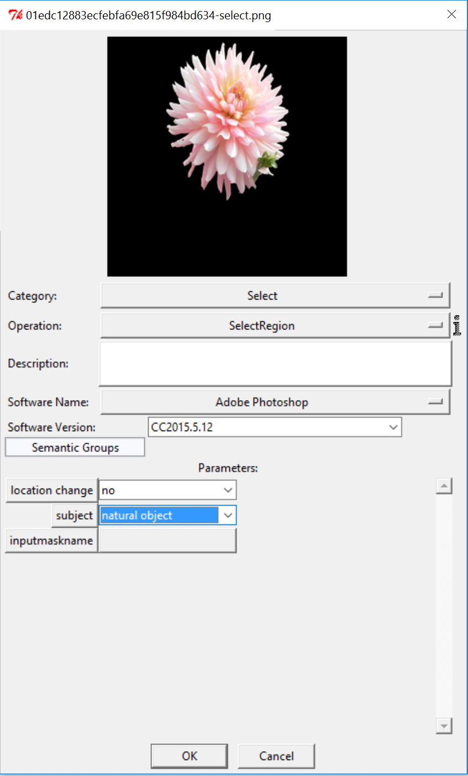


Select Region

Slide 55


Select Remove
before
Used for refining edges of added pixels or completely deleting pixels
after

Slide 56
Transform
Resize
Remove
Rotate
SeamCarving
ImageInterpolation
Shear
Warp
ContentAwareScale
Distort
Crop
Skew
Flip
Affine

